Slide 1
ST1 Skin Pathology
Dr Nidhi Bhatt

Slide 2
Outline
Normal histology
Common benign entities
Common malignancies and pre invasive lesions
Melanocytic lesions

Slide 3
Normal histology

Slide 4
Layers of Skin
Epidermis
Keratinising squamous epithelium
Dermis
a) papillary layer
small blood vessels, lymph & nerves
fine collagen & elastic fibres
b) reticular layer
vascular plexus, lymph, nerves & appendages
compact collagen fibres & thick elastic fibres
Subcutaneous
mainly adipose tissue

Slide 5
Normal skin
Pilosebaceous unit
Papillary dermis
Epidermis
Reticular dermis
Eccrine glands

Slide 6
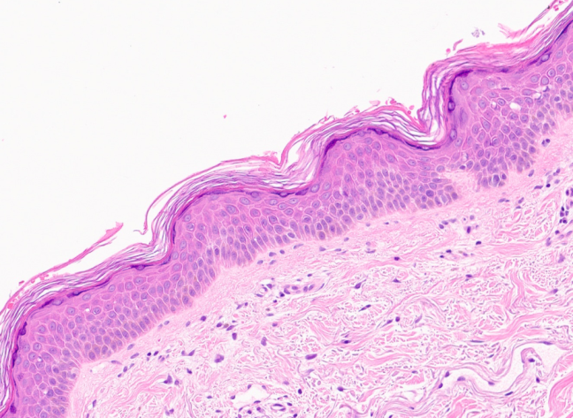
Epidermis

Slide 7
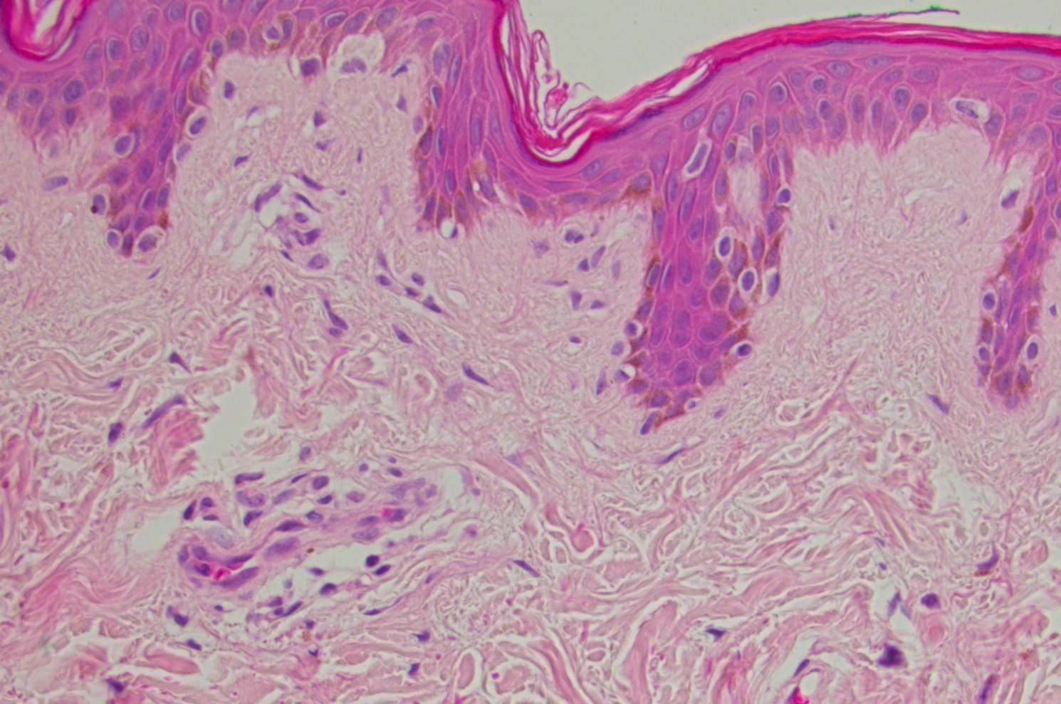
Dermal papilla
Pigment
Basal melanocytes
Rete Peg

Slide 8
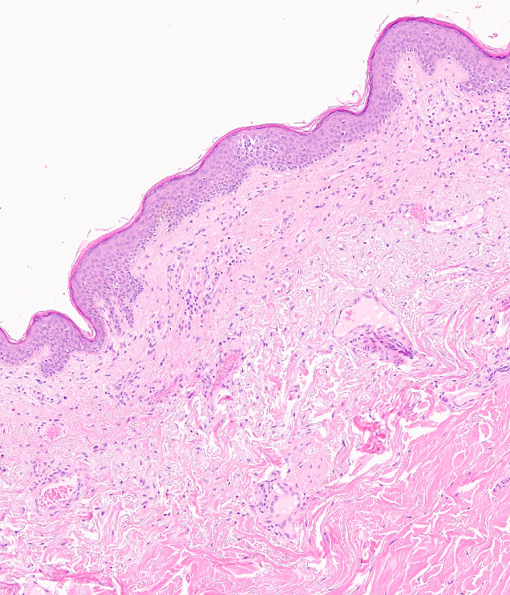
Dermis

Slide 9
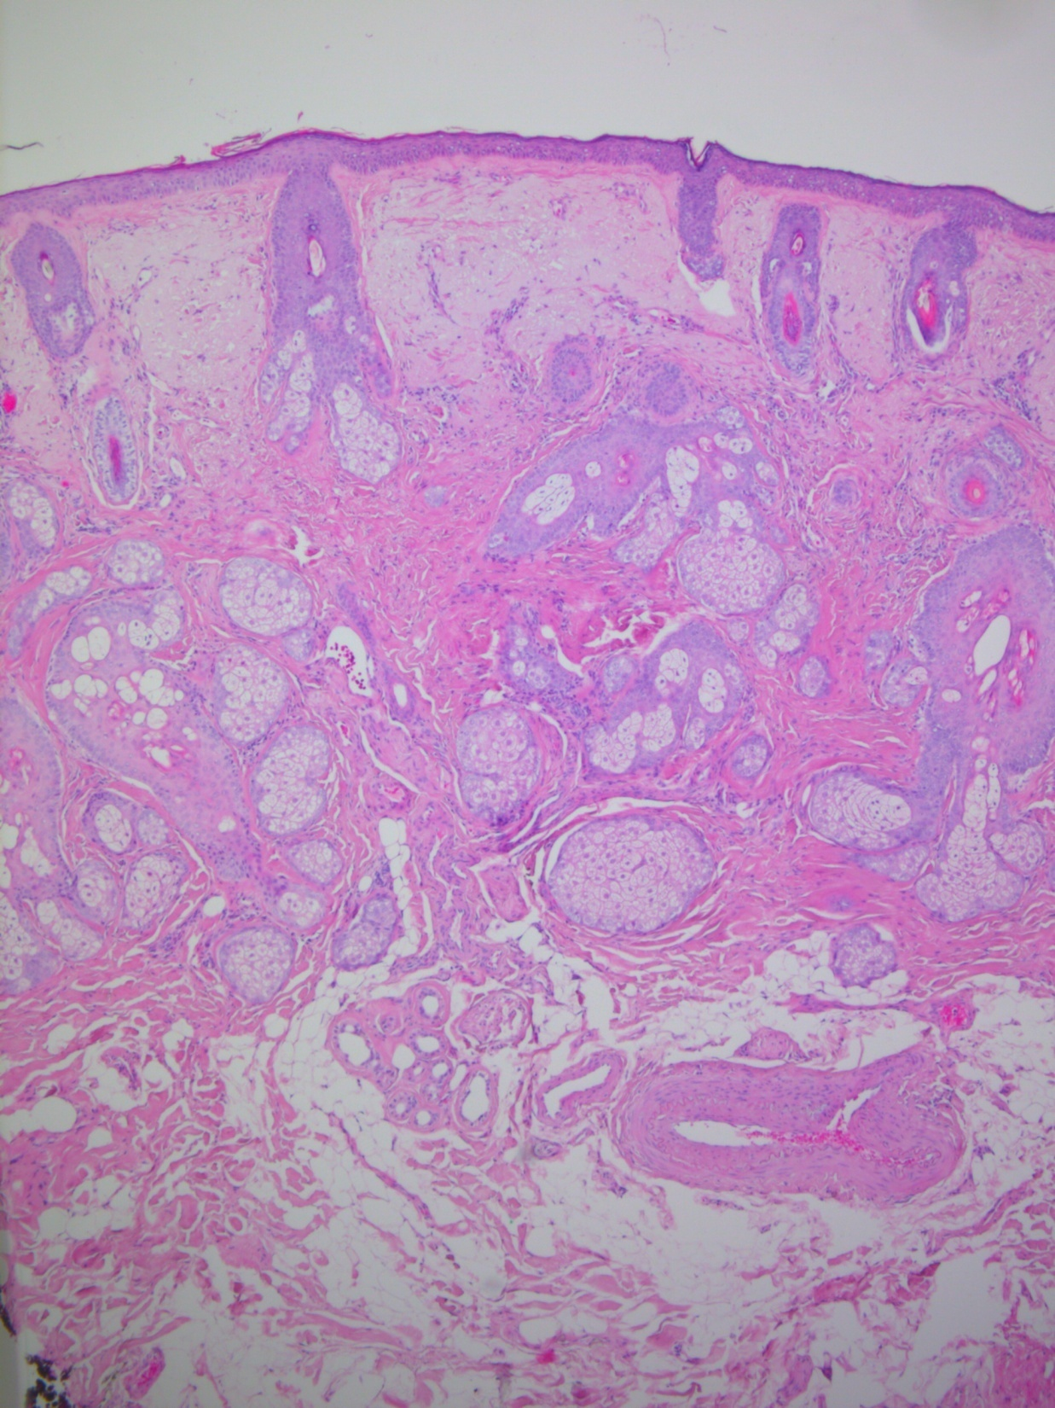
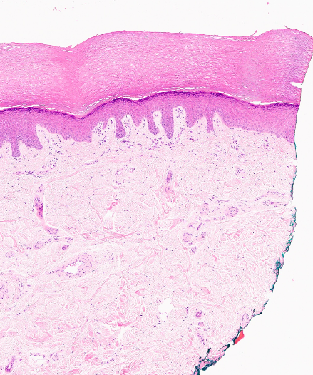
Normal variations with site

Slide 10
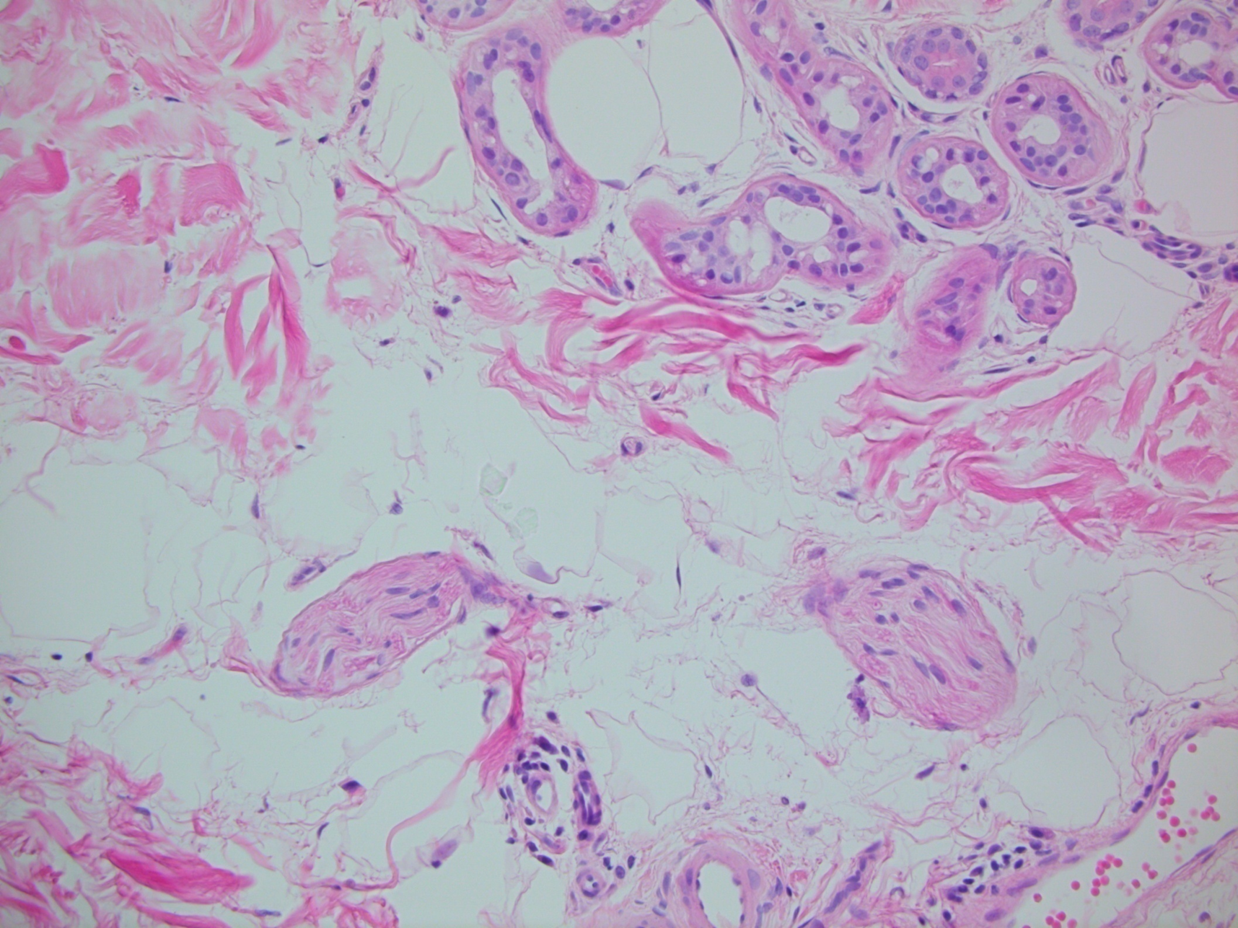
Peripheral nerve

Slide 11
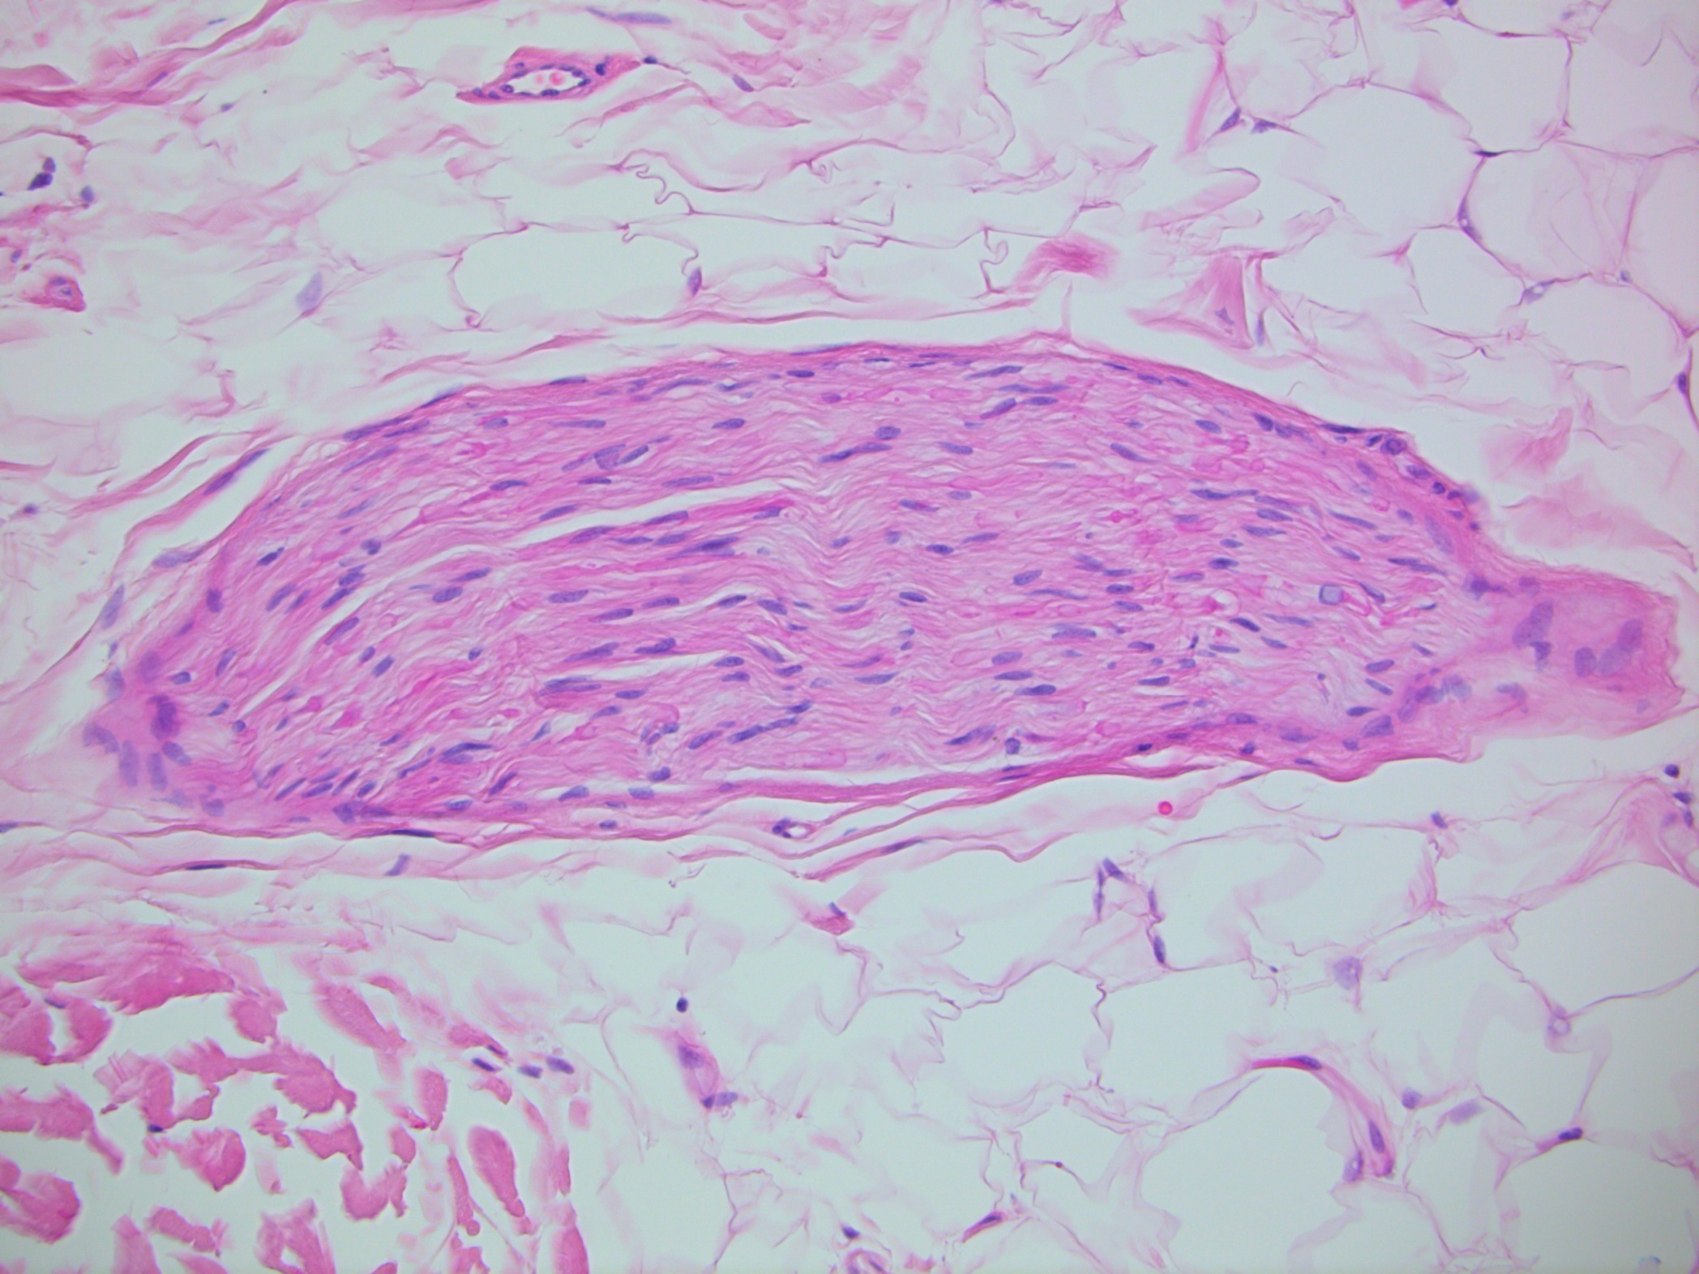
Peripheral nerve

Slide 12
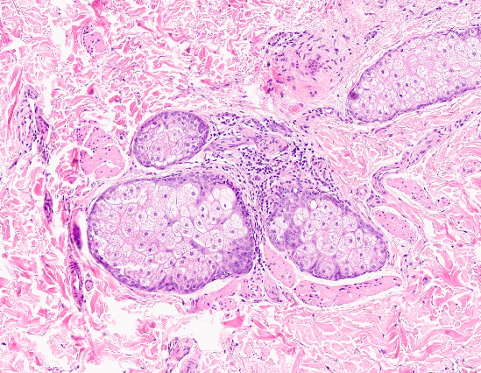
Pilar muscle

Slide 13
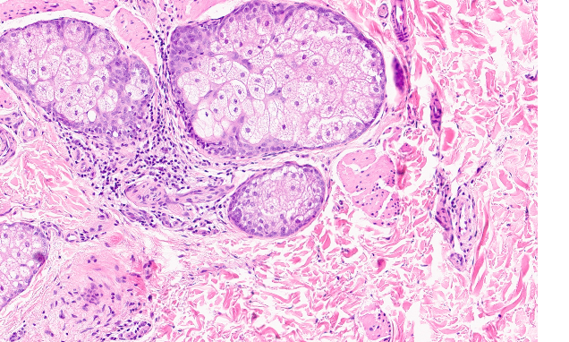
Pilar muscle vs nerve

Slide 14
Common benign entities

Slide 15
Seborrhoeic keratosis
● Usually 40+ years ● Benign, although may coexist with dysplasia or malignancy ● Usually affects trunk, head and neck, extremities ● Only hair bearing skin
Stucco keratosis (common variant of Seb K)
● men >> women, extensor surfaces of arms/legs
Microscopy
Basal keratinocyte proliferations, no atypia, (smooth demarcation of lesion from dermis)
Various patterns - acanthotic, irritated, clonal, hyperkeratotic and inverted follicular keratosis

Slide 16
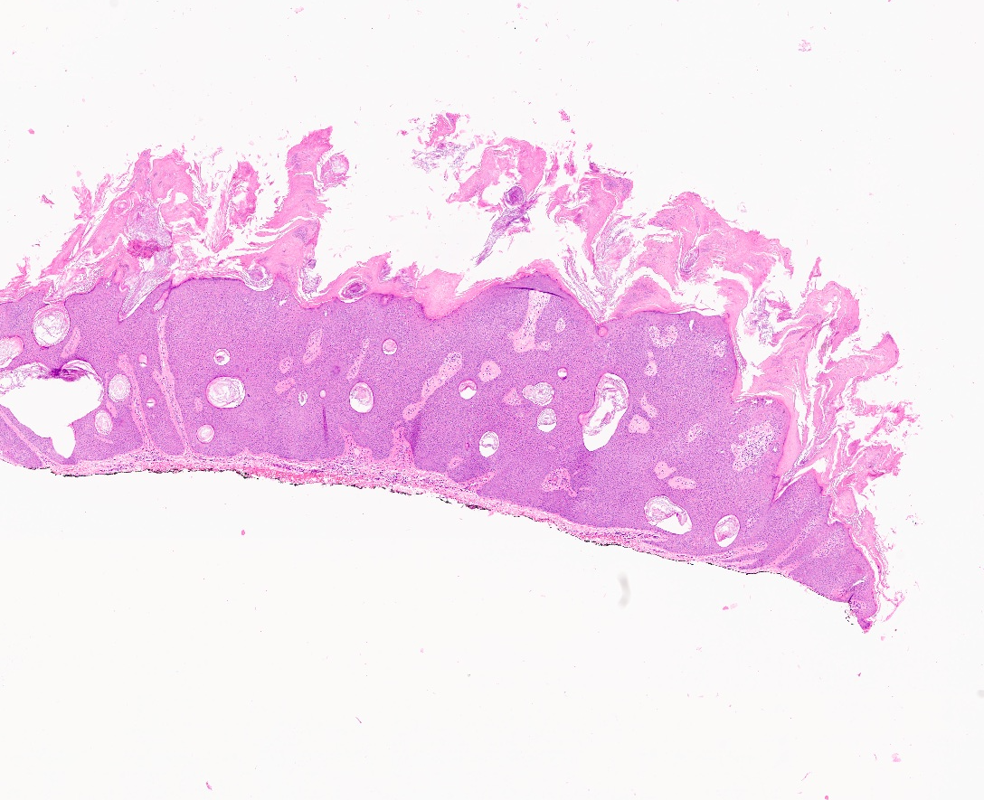

Slide 17
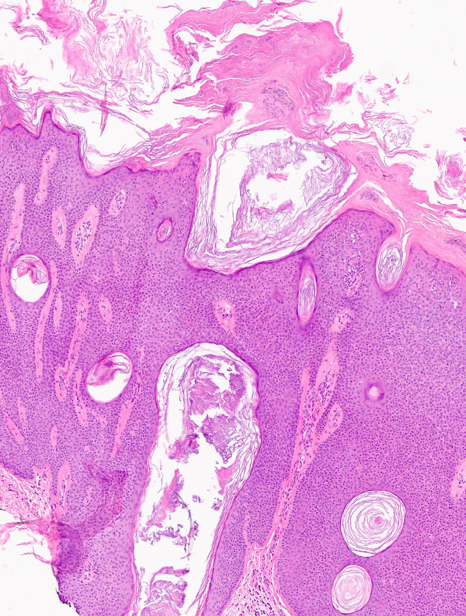

Slide 18
Keratinous (follicular) cysts
Most skin cysts arise from the pilosebaceous unit
Common ones:
Epidermoid cyst – follicular infundibulum
Pilar cyst – follicular isthmus

Slide 19
Epidermoid cyst
Young to middle aged usually affected
Upper trunk, face and neck common sites
Present as a dome shaped swelling sometimes with a punctum
Usually forms due to obstruction of the upper part of hair follicle or secondary to trauma
Rarely, may be associated with syndromes such as Gorlin-Goltz and Gardner syndrome if multiple
Diagnosis can be made on macroscopic examination – cheesy material oozes out on slicing, thin walled cyst
Lined by keratinising squamous epithelium with granular cell layer, contain laminated keratin

Slide 20
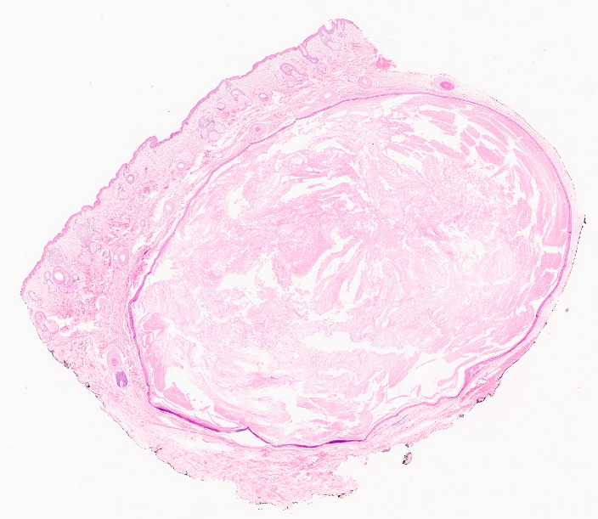

Slide 22
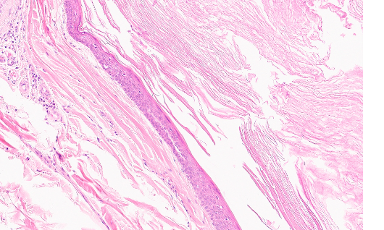

Slide 23
Pilar cyst
More common in females
90% affect the scalp and approx 70% are multiple
Devoid of a punctum
Smooth yellowish intradermal swellings that shell out at surgery
May be hereditary
Diagnosis can be made on macroscopic examination – firm, yellowish cut surface with a thick capsule
Lined by keratinising squamous epithelium devoid of a granular cell layer, palisaded appearance, contain amorphous keratin

Slide 24
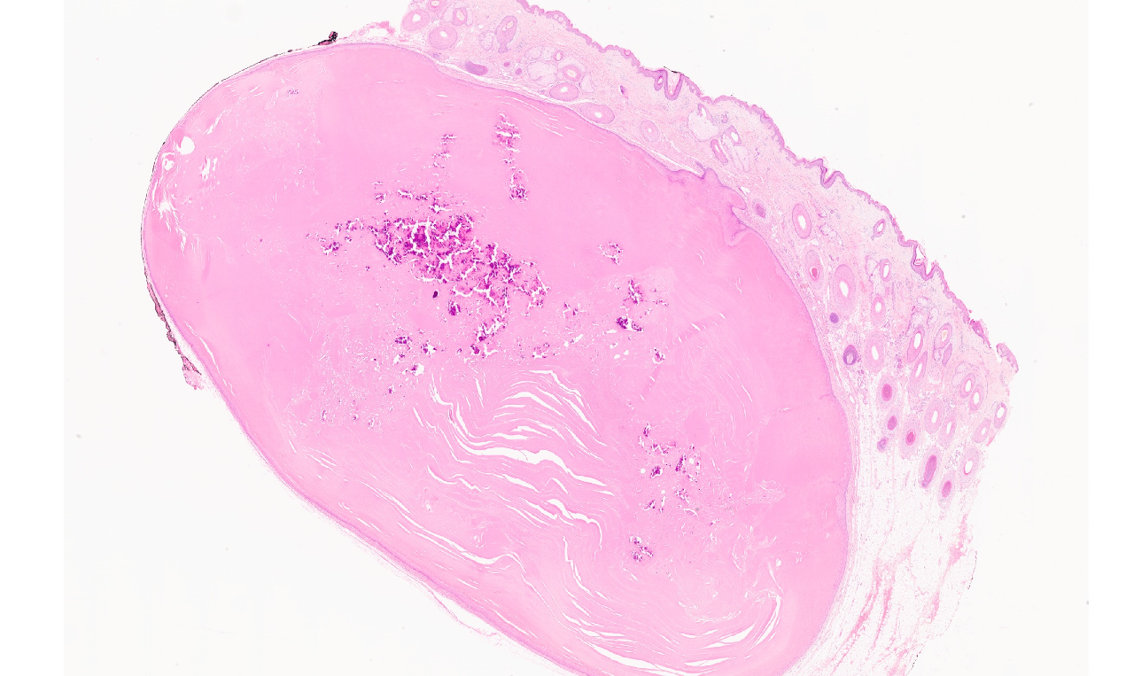

Slide 25
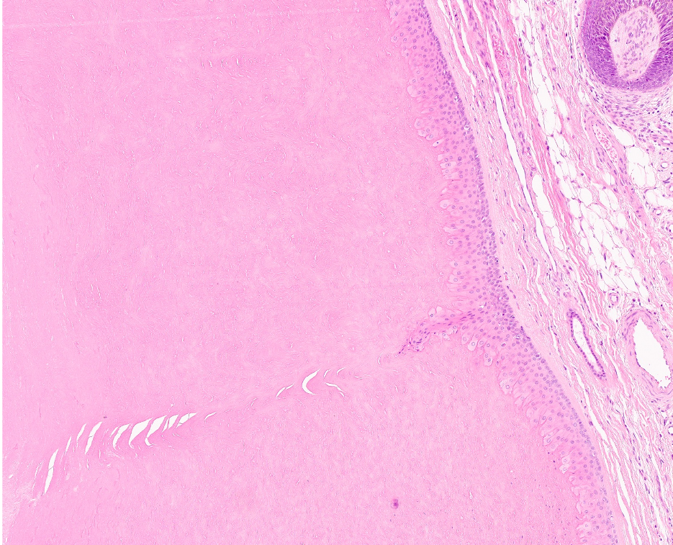

Slide 26
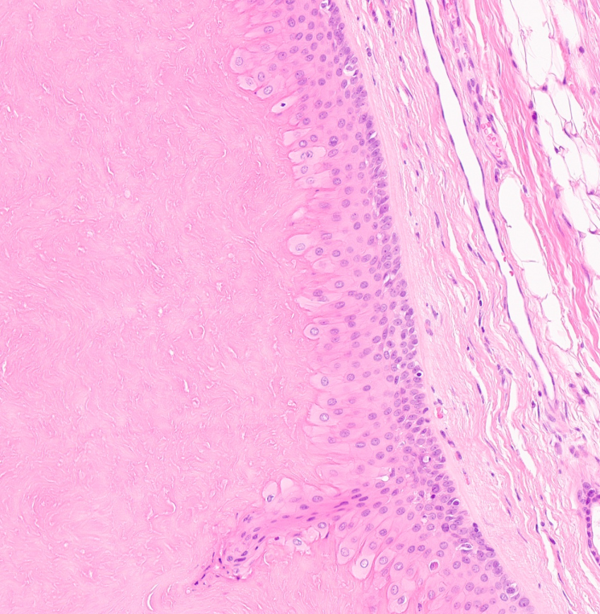

Slide 27
Epidermal Dysplasia

Slide 28
Actinic keratosis
● Build up of excessive keratin due to chronic exposure to sunlight ● Sun-exposed sites (face, arms, dorsum of hands) Risk factors: ● Fair skin, ionizing radiation, hydrocarbon or arsenic exposure, renal transplant Variants: ● Acantholytic: lack of intercellular adhesion ● Atrophic: epidermis has only 3-4 layers of keratinocytes ● Basaloid ● Bowenoid: full thickness atypia ● Hyperkeratotic: with cutaneous horn ● Pagetoid
Histology:
● <full thickness keratinocyte atypia and disorderly maturation, hyperkeratosis, parakeratosis
● Usually loss of granular layer

Slide 29
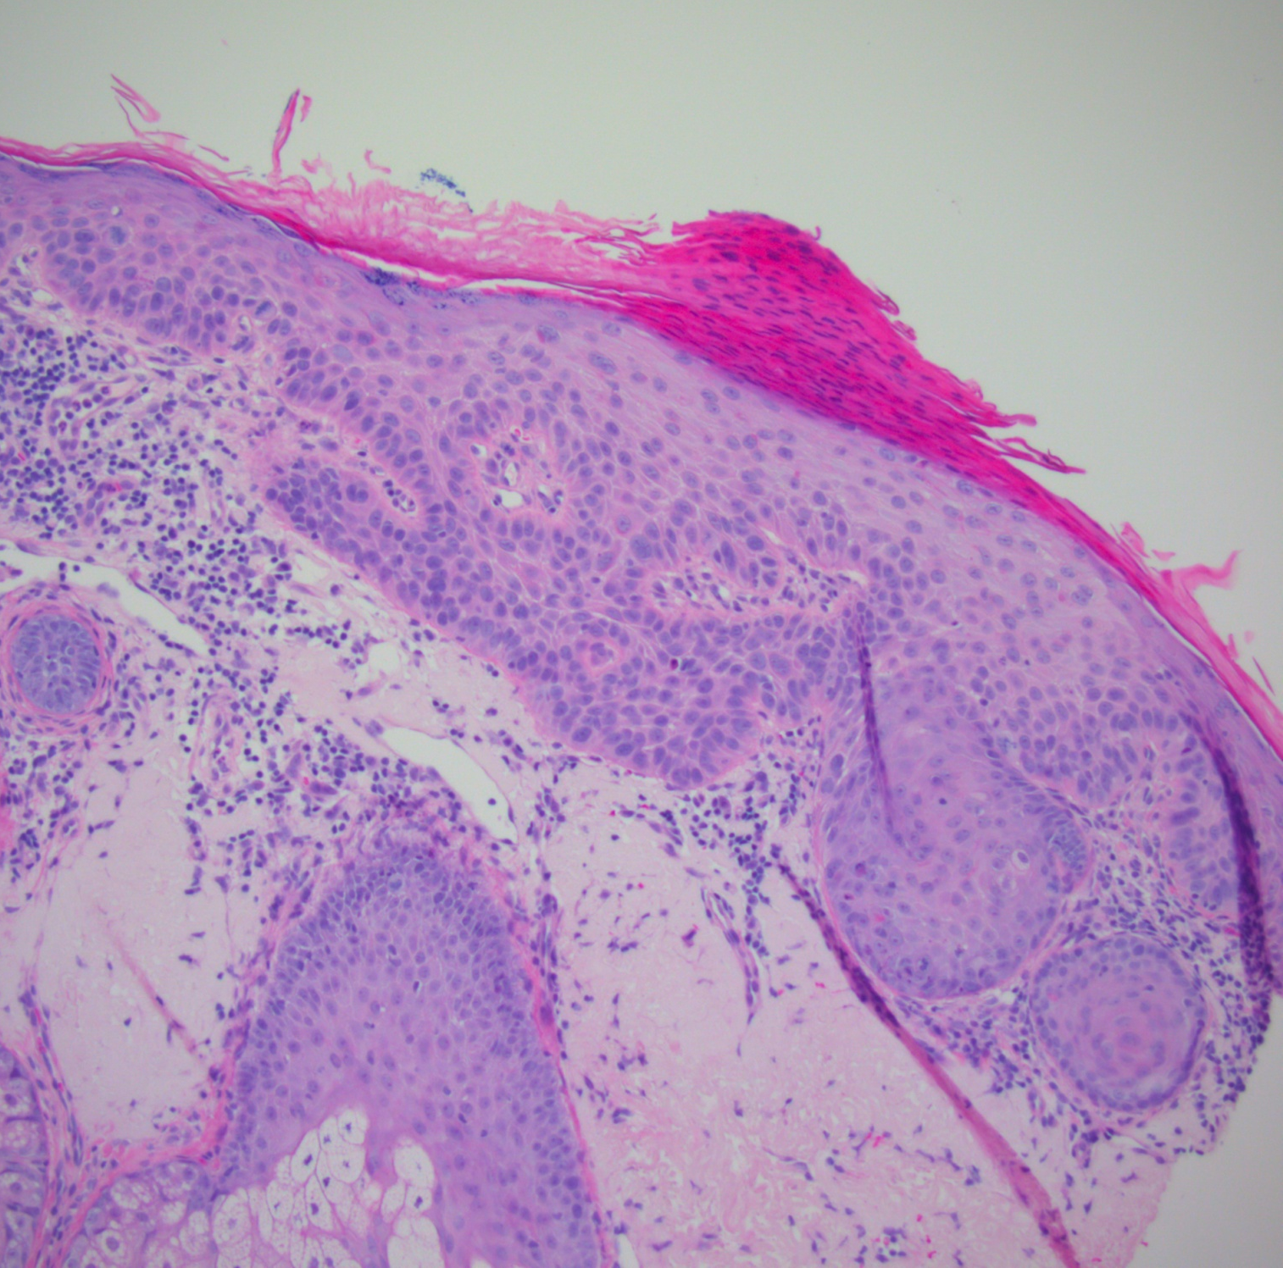

Slide 30
Bowen’s disease
Full thickness dysplasia of epidermis
Often on skin NOT exposed to sunlight, such as trunk
May be associated with immunosuppression
Can also be seen on sun exposed areas (often referred to as Bowenoid AK)

Slide 31
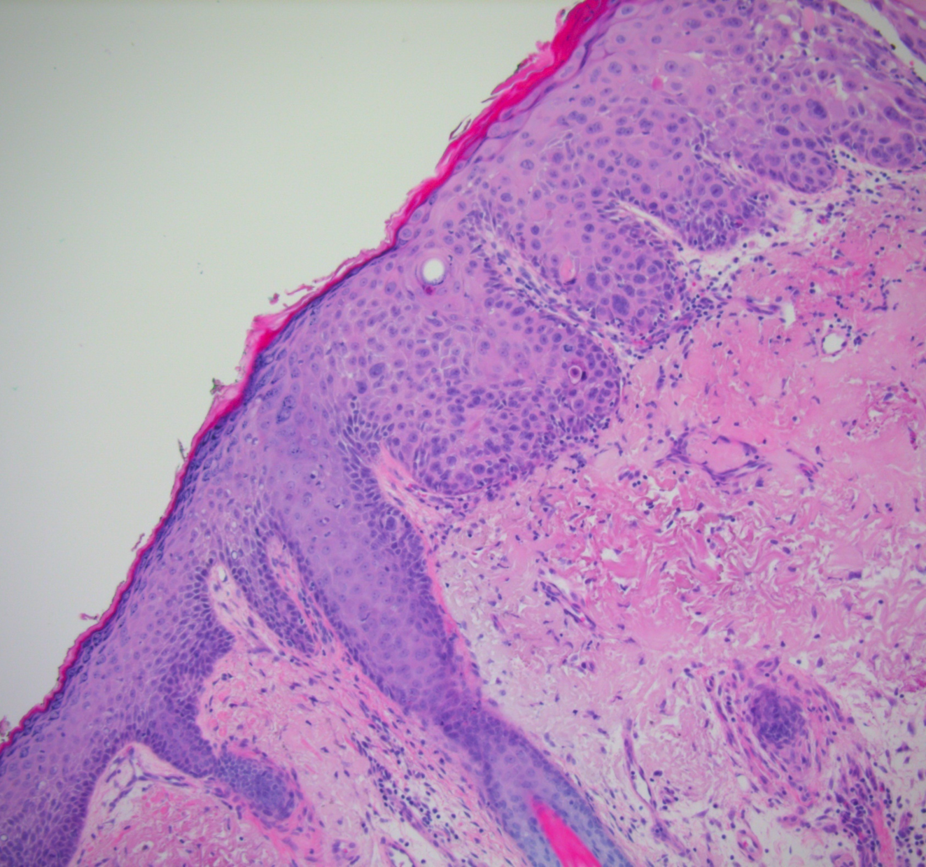

Slide 32
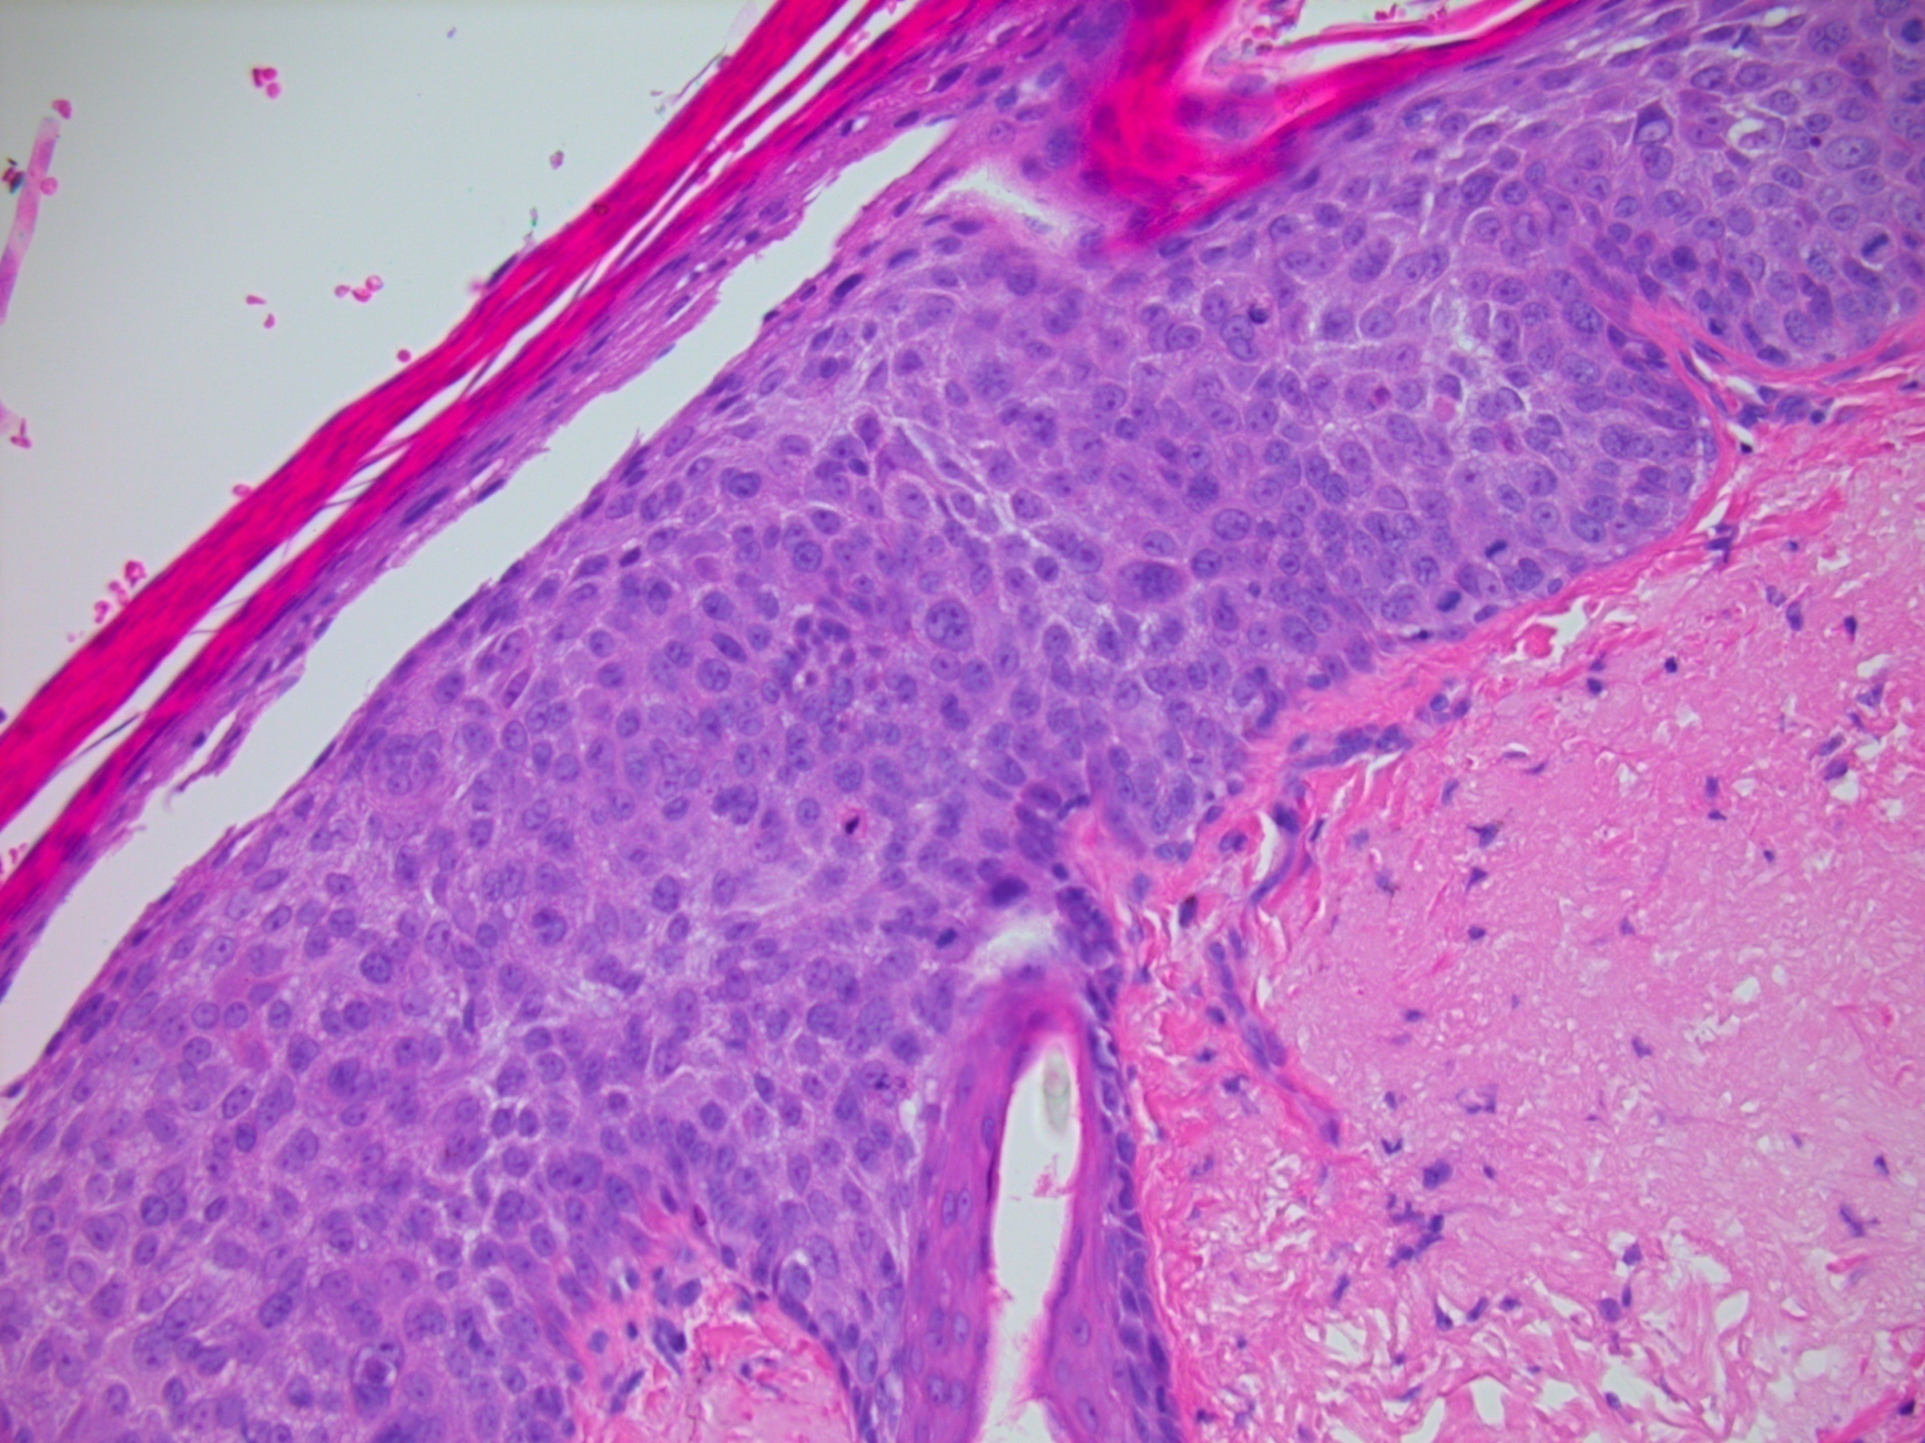

Slide 33
Basal cell carcinoma

Slide 34
Basal cell carcinoma
Most common malignancy of skin, constitutes ~80% of all skin cancers
Usually in patients >40 years of age
men >women (male:female = 1.6:1)
Sites
Mainly sun exposed skin, in any hair bearing area (e.g. head and neck)
Aetiology
Associated with UV light exposure (particularly intermittent intense exposure), history of radiation treatment
Associated with various syndromes: Gorlin syndrome
Subtypes
Low risk subtypes - Nodular, superficial, fibroepithelioma of Pinkus
High risk subtypes - Infiltrative, morphoeic, micronodular, basosquamous, sarcomatoid

Slide 35
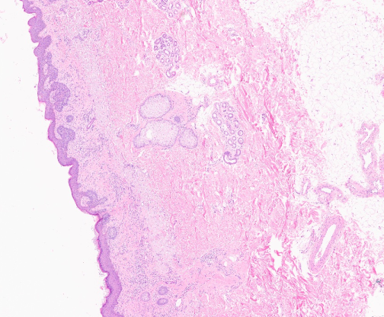
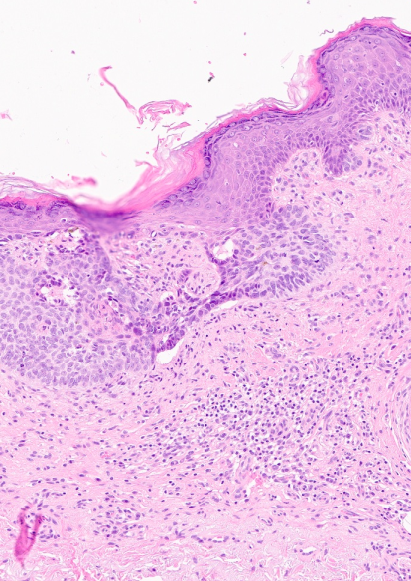
Superficial BCC

Slide 36
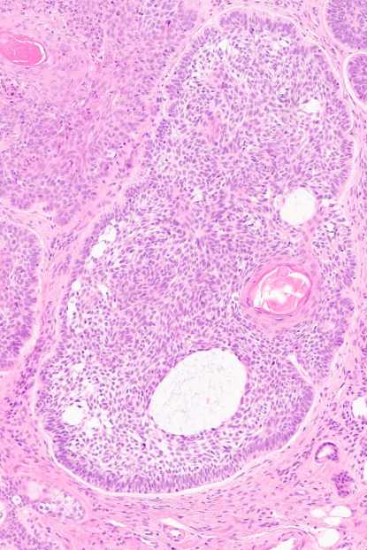
Nodular BCC

Slide 37
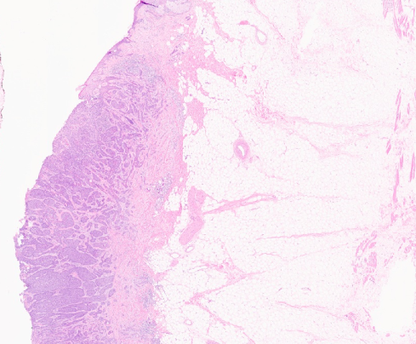
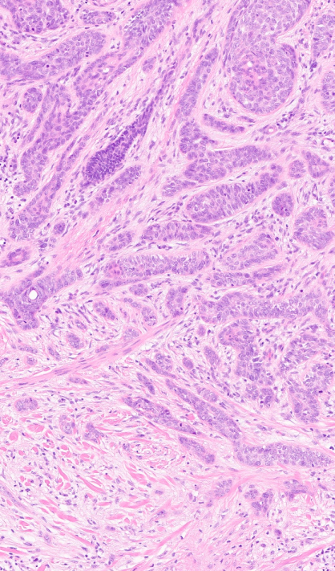
Infiltrative BCC

Slide 38
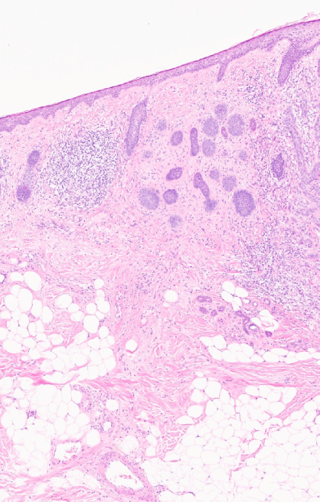
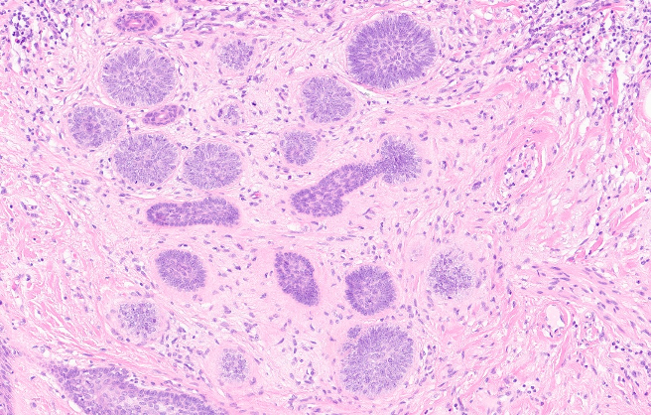
Micronodular BCC

Slide 39
Reporting BCC
Low and high risk subtypes
Deep invasion (thickness >6mm, invasion beyond subcutis)
Perineural invasion (also, lymphovascular invasion but exceedingly rare)
Margins
Stage

Slide 40
Squamous cell carcinoma

Slide 41
Squamous Cell Carcinoma
2nd most common invasive skin cancer, after basal cell carcinoma
Derived from keratinocytes in epidermal layer
Usually >60 years (but increasing sun exposure in younger population)
Risk factors include UV light, burn scars, chronic ulcers, immunosuppression, HPV
Increasingly with advent of targeted gene therapy, EGFR and BRAF inhibitors are associated with SCC
An associated precursor lesion (actinic keratosis / Bowen’s) is often present – but graded progression is not a feature
Grading system exists ranging from well to poorly differentiated based on degree of keratinisation and cytological atypia, but can be subjective in practice, the worst grade should be reported (not the predominant one)
Subtypes: acantholytic, desmoplastic, spindle cell, basaloid, keratoacanthoma-like, verrucous

Slide 42
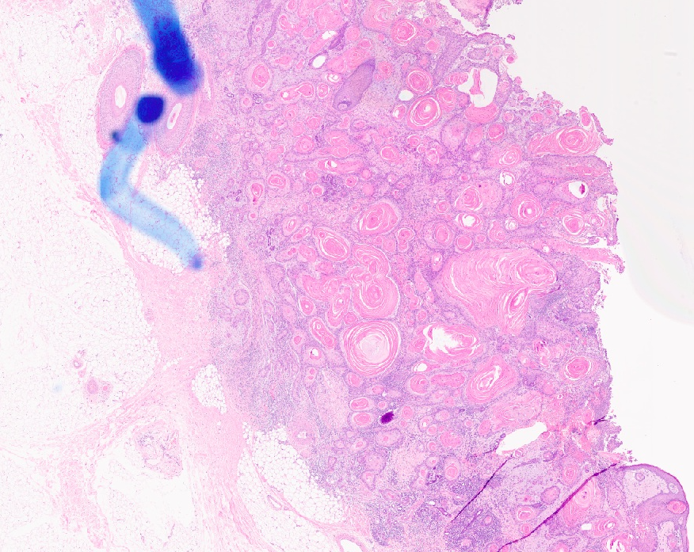

Slide 43
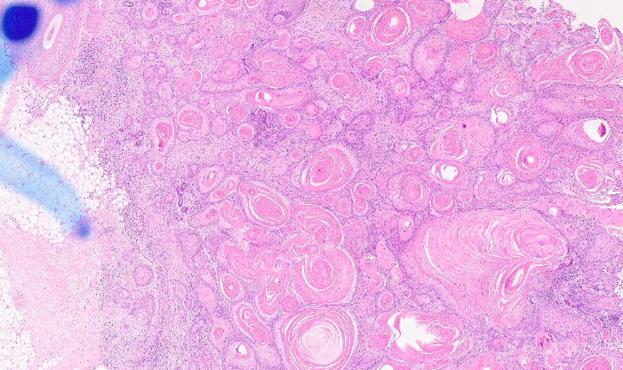

Slide 44
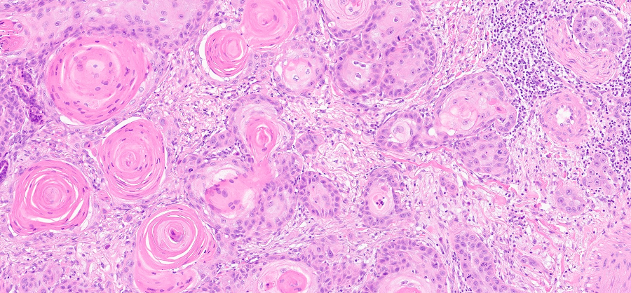

Slide 45
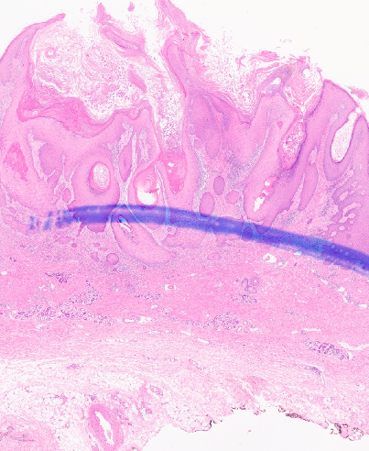

Slide 46
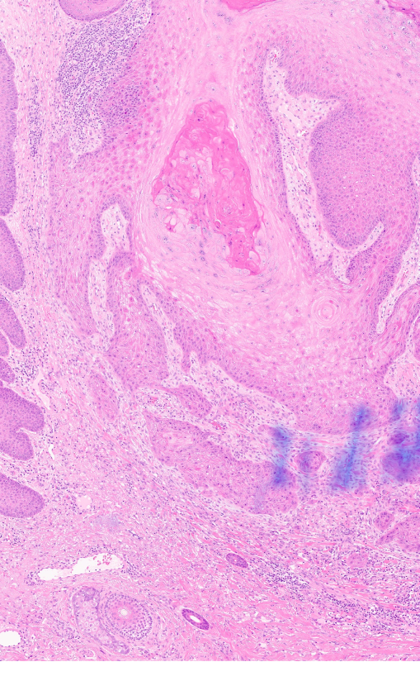
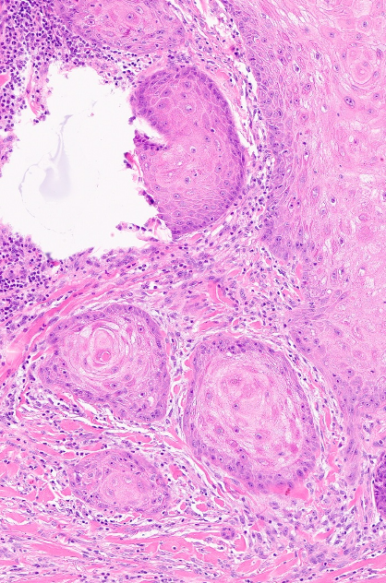

Slide 47
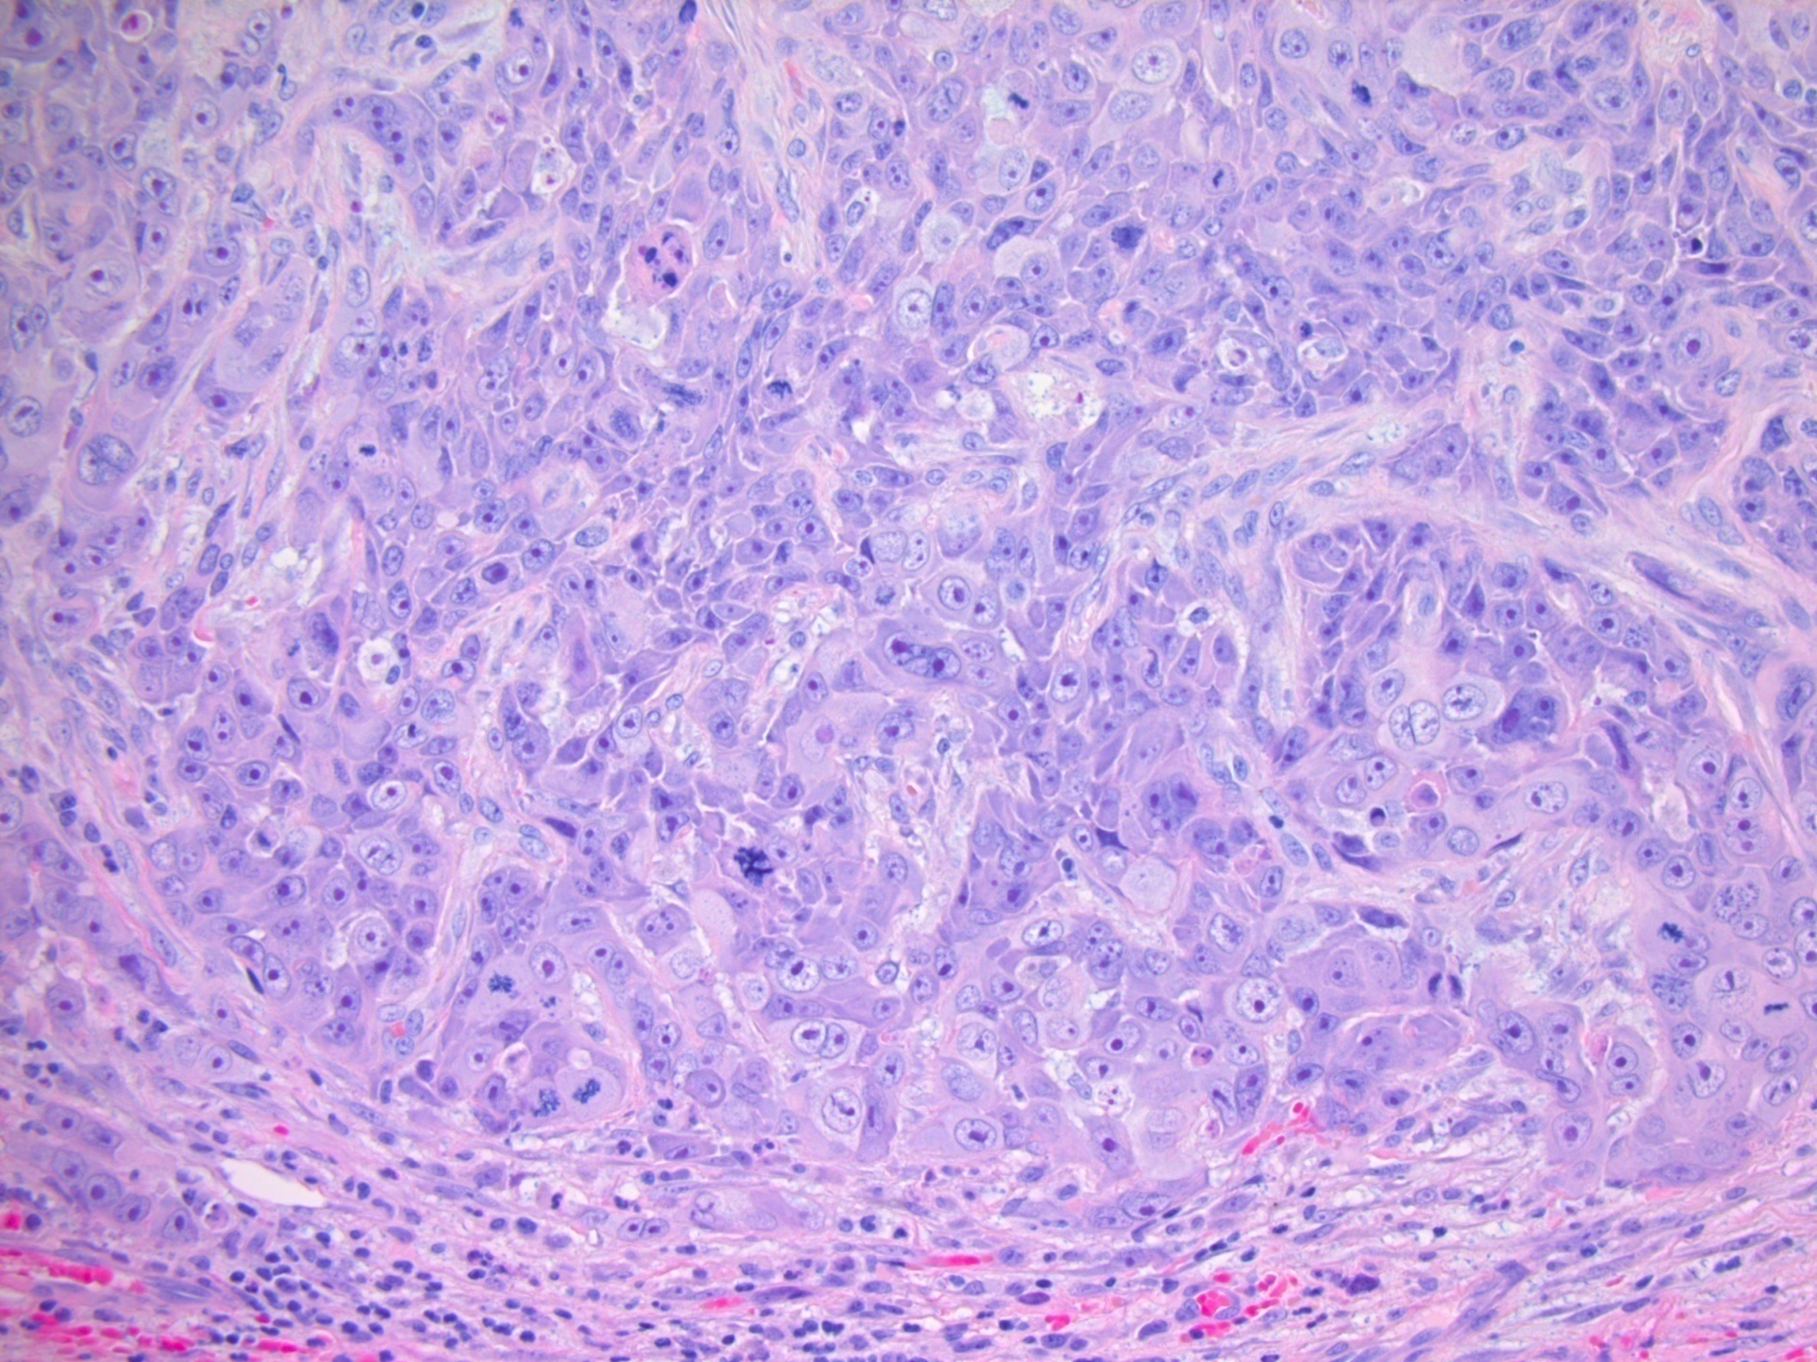

Slide 48
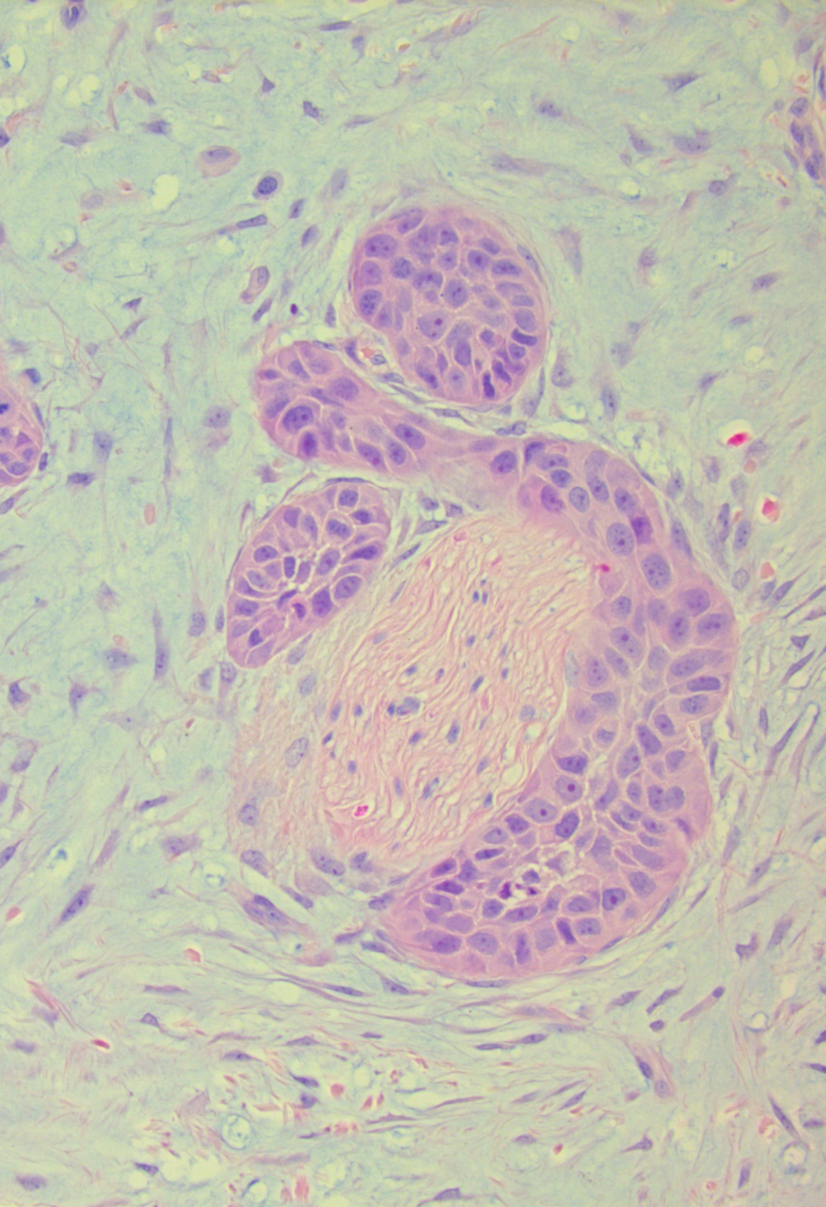

Slide 49
Reporting SCC
Subtype
Grade of differentiation
Tumour thickness
Level of invasion (criteria for deep invasion same as for BCC)
Vascular and perineural invasion
Margins
Stage

Slide 50
Melanocytic lesions

Slide 51
Benign acquired naevi
Melanoma (in situ and invasive)

Slide 52
Benign Acquired Naevi
Junctional Younger
Compound ↓
Intradermal Older
Development of naevi relates to the extent of sun exposure during 1st 2 decades of life. Intermittent intense sun exposure is more important than chronic sun exposure

Slide 53
Features of Benign Naevi
Symmetrical
No evidence of upward spread
Downward maturation (architectural, cytological)
Lack atypia (not hyperchromatic, angulated, absent/small nucleoli)
No mitotic activity
No expansile growth/destruction of other structures

Slide 54
Junctional naevi – nests confined to epidermis

Slide 55
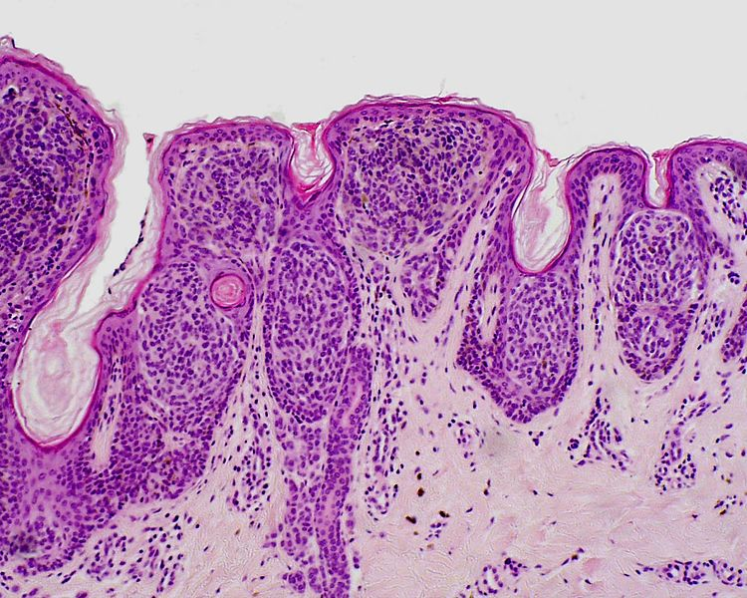

Slide 56
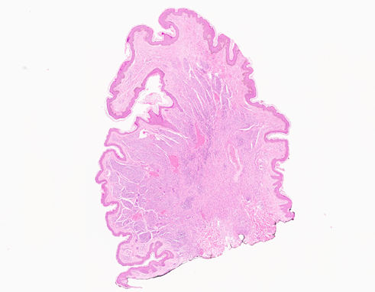
Intradermal naevus – naevus cells entirely in the dermis

Slide 57
Intradermal naevus – naevus cells entirely in the dermis

Slide 58
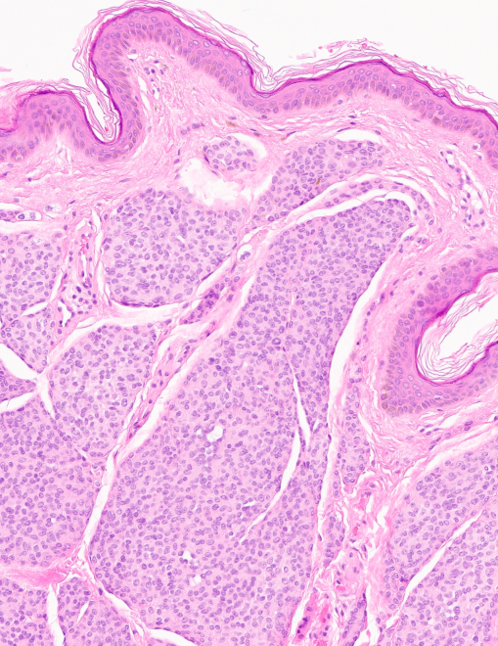
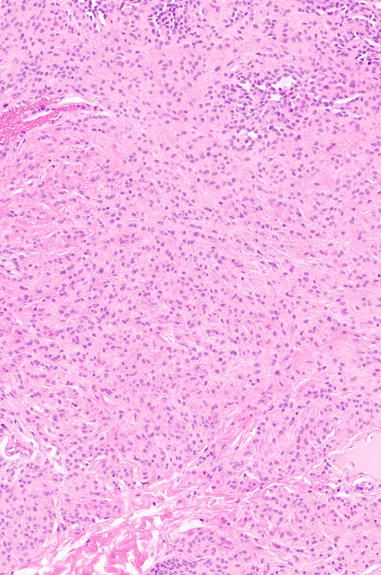
Superficial part
Deep part

Slide 59
Compound naevus – nests in epidermis and dermis

Slide 61
Features of Benign Naevi
Symmetrical
No evidence of upward spread
Downward maturation (architectural, cytological)
No atypia (not hyperchromatic, angulated, absent/small nucleoli)
No mitotic activity
No expansile growth/destruction of other structures

Slide 62
Melanoma

Slide 63
Melanoma
5th most common cancer in the UK – 86% cases are thought to be preventable
Incidence rates risen by 138% from the 90s
Highest incidence over the age of 85
But, increasing steadily in 20-25yo and steeply in males 55-59yo
In younger age groups, incidence in females >> males
In older age groups, incidence in males>>females
Trunk, head and neck – mainly in males
Legs and arms – mainly in females
Data from CRUK 2017

Slide 64
Melanoma
Majority of melanomas arise de novo
Most related to UV exposure (sun, sunbeds)
Risk higher in people susceptible to the effects of sunlight exposure (those who sun-burn than those who tan)
8-14% are familial
Subtypes of melanoma are associated with varying intensity and duration of UV exposure

Slide 65
Melanoma
In situ (MIS):
Confined to the epidermis and invading the epidermis (pagetoid spread)
Asymmetrical, Variably sized nests and lentiginous runs
Cytological atypia
“Lentigo maligna” when in chronically sun-damaged skin, usually minimal pagetoid spread and nesting
Invasive melanoma:
Invades the dermis
All features of MIS in the epidermal component
Similar melanocytes in the dermis, haphazardly arranged
Lack of maturation in the dermal component
Mitotic activity in the dermal component
2 growth phases – vertical and radial

Slide 66
Subtypes
Superficial spreading melanoma
High intensity intermittent UV exposure
Lentigo maligna melanoma
Low intensity UV exposure for longer duration
Lentigo maligna may pre-exist for 10-15 years
Acral melanoma
Develops on palmar and plantar surfaces
Nodular melanoma
Vertical growth phase from inception (worse prognosis)

Slide 67
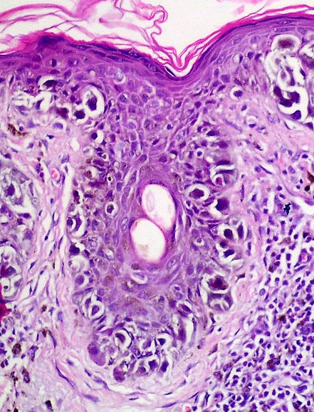
Lentigo maligna
Melanoma in situ

Slide 68
MIS
Naevus

Slide 69
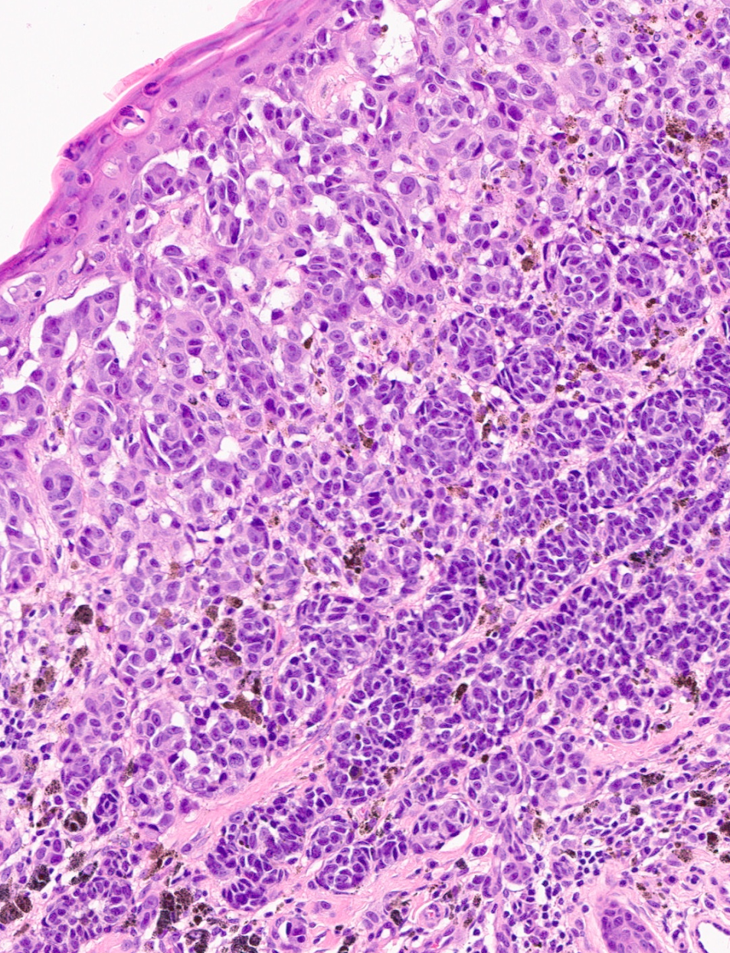
Radial growth phase
Vertical growth phase

Slide 70
Superficial spreading melanoma

Slide 72
Acral melanoma

Slide 73
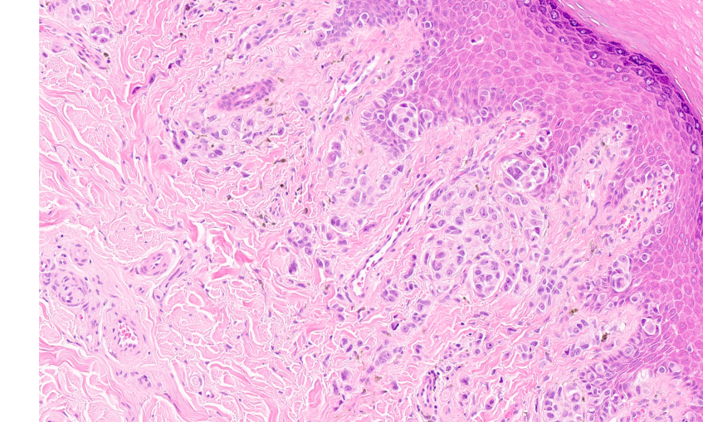

Slide 74
Breslow thickness

Slide 75
Regression

Slide 76
Reporting melanoma
Subtype
Growth phase
Breslow thickness
Regression
Ulceration
Lymphovascular and perineural invasion
Microsatellites
Mitotic count per mm²
Margins
Staging

