Slide 1
The NHS Cervical Screening programme
Dr Karin Denton
Consultant Cytopathologist, NBT

Slide 2
Principles of screening
The natural history of the disease must be understood
The condition must have an early asymptomatic stage
The condition must be important
There must be a test which can detect early stage disease, which is sensitive and specific
There must be a treatment which if given at the time of early disease detection improves outcome
The harms of the test and treatment must not outweigh the benefits of early detection

Slide 3
Cervical screening
More than any other condition currently screened for , meets these criteria.

Slide 4
Important Health Problem
Incidence
471,000 new cases worldwide annually; 80% in less developed world
2% of all cancers in women in UK
Mortality
233,000 deaths annually worldwide
11th most common cause of cancer deaths in UK
Notes:
In third world countries where there are no screening programmes it is one of the most comon killers

Slide 5
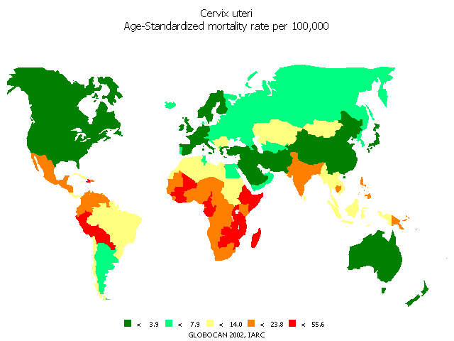
Cancer of the cervix (mortality/100,000)
<3.9
<7.9
<14.0
<23.8
<55.6
Mortality falling developed world
Mortality rising in developing world

Slide 6
Natural history
Initiating event is infection with High risk HPV
Factors impacting this are
    Number of sexual partners,
    age at first intercourse,
    immunosuppression,
Smoking is a cofactor
75% lifetime risk of HPV infection
Prevalence greatest under 25 years (up to 30%)
Infection usually transient, asymptomatic and resolve spontaneously
Notes:
CIN3 shows a peak in women aged 25-29
Invasive Carcinoma peaks in late 40’s
Can take 10-20 years for CIN to progress to cancer
Some cases of CIN may regress to normal

Slide 7
HPV infection
Most episodes are self limiting over 18-24 months
In some women HPV DNA becomes integrated into host DNA. These cases are at risk of progression
Several HPV types are implicated ( in total around 15 types associated with cervical cancer)

Slide 8
High-risk HPV types causing cervical cancer
HPV type | Percentage of cervical cancer cases caused by HPV type | Cumulative percentage
16 | 58.1% | 58.1%
18 | 15.7% | 73.8%
33 | 4.4% | 78.2%
31 | 4.0% | 82.2%
45 | 2.9% | 85.1%
35 | 1.6% | 86.7%
58 | 1.2% | 87.9%
56 | 1.0% | 88.9%
52 | 0.6% | 89.5%
39 | 0.2% | 89.7%
51 | 0.2% | 89.9%
68 | 0.3% | 90.2%
59 | 0.1% | 90.3%
Other | 1.4% | 91.7%
No type identified | 8.3% | 100%
Notes:
This slide shows, in terms of percentages, what proportion of cervical cancer cases are caused by different high-risk HPV types.
HPV types 16 and 18 cause 73% of cervical cancer cases in Europe.

Slide 9
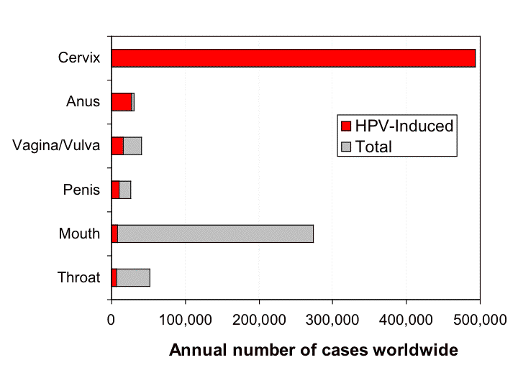
Notes:
88% anus, 70%vagina, 43%vulva ,50%penis, 26.6% oropharynx are HPV related. 16 most common.

Slide 10
Cervical screening in the UK
AIM:
To reduce the number of women who develop invasive cervical carcinoma (the incidence) and the number of women who die from it (the mortality)

Slide 11
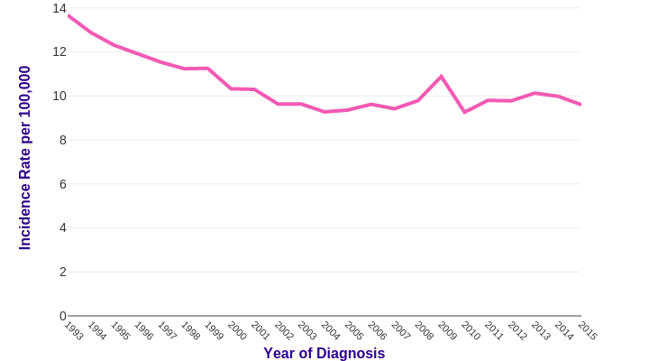
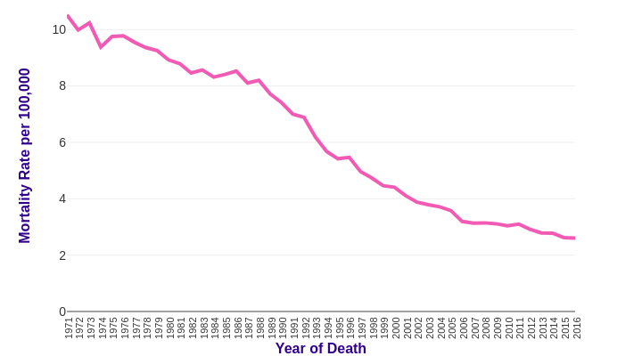
Effect on Cancer Incidence and Mortality

Slide 12
Cervical Screening Programme
Population data base
Computerised call and recall
Failsafe
Sample taking
HPV testing
Cytology
Histology
Colposcopy
Cancer registry
Quality assurance
Commissioning, Oversight and steering

Slide 13
Cervical Screening in the UK
A national screening programme
Whole screening pathway
Lifetime of woman

Slide 14
National screening committee
Makes evidence based decisions about screening protocols

Slide 15
The Call and Recall System
Sends invitation and reminder letters
Sends results letters
Completes annual statistics
Notes:
Korner returns from 152 pc org

Slide 16
The Primary Care Team
GP surgery or CASH clinic
Take cervical samples
Ensure results are returned to woman
Encourage women to be screened
Answers questions and concerns about test, results, follow up and treatment

Slide 17
Before taking the sample
Discussion about purpose of test,
false negatives,
Results,
how results will be notified
It is the sample taker’s responsibility to inform the woman in writing of her result
A negative result indicates low risk but not no risk of developing cervical cancer

Slide 18
The laboratory/laboratories
Process and interpret the cervical samples and biopsies
HPV primary screening
All abnormal cytology reported by consultants
Sends results to GP and Primary Care Support Agency
Oversees direct referral to colposcopy
Runs a failsafe system to ensure that all abnormal tests are followed up
National statistical return
Report histology

Slide 19
The Colposcopy Service
Diagnosis and treatment
  Take biopsies
  Treatment
Failsafe system for follow up of all patients treated
National statistical return

Slide 20
Colposcopy
Observation of the cervix using binocular magnification
Looks for:
  Visibly abnormal areas
  Vascular patterns
Can identify and treat CIN
Can reassure women who do not require treatment

Slide 21
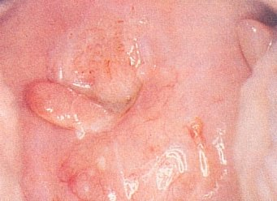
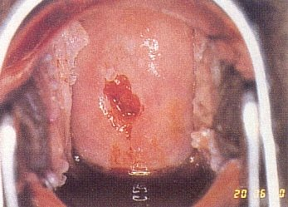
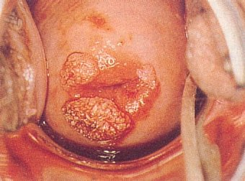
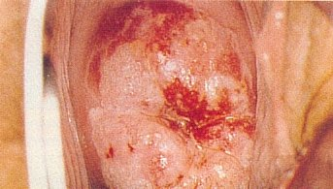
Visible Abnormalities

Slide 22
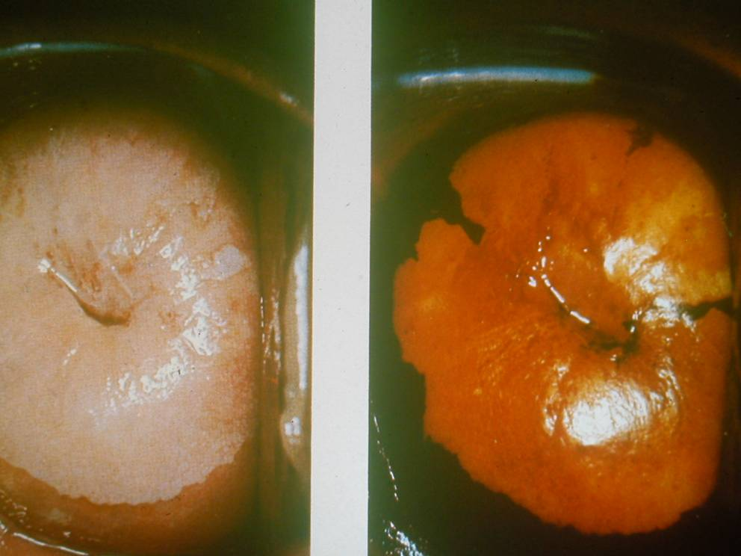
CIN
Does not usually produce changes visible to the naked eye
Can apply solutions to identify abnormal areas

Slide 23
Treatment
Ablative
  Electrodiathermy
  Cryotherapy
  Cold coagulation
  Laser vaporisation
Excisional
  Surgical cone biopsy
  Laser
  LLETZ
  Hysterectomy

Slide 24
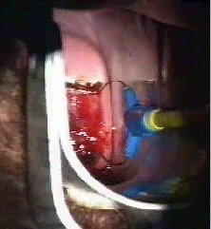
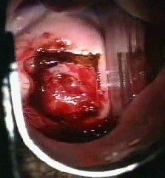
Large Loop Excision of the Transformation Zone (LLETZ)

Slide 25

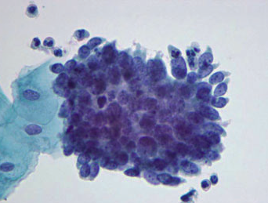
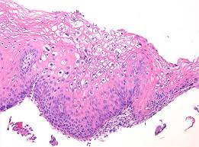
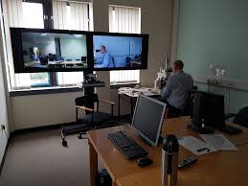
Multidisciplinary working
Referral cytology High Grade dyskaryosis (severe)
Original Histology report CIN1 and HPV
Final Diagnosis
High Grade CGIN

Slide 26
Cervical screening
Part of a broader cervical cancer prevention programme
HPV vaccination

Slide 27

Prophylactic vaccines
- Virus Like Particles (VLPs)
Resemble intact viruses - no DNA
Recombinant L1 structural protein
Self-assemble into Virus Like Particles
L1 protein
Non infectious
Immunogenic - Neutralizing Antibodies

Slide 28
Key findings
Very highly effective in preventing infection with type specific HPV in a naïve population
Protection lasts several years at least
Very low effectiveness in women with a current infection
Reduced effectiveness with a previous cleared infection

Slide 29
Vaccine development
Originally 2 vaccines
  Gardasil - 6,11,16,18
  Cervarix – 16,18
    Better cross protection against other high risk types
Nonavalent vaccine ( Gardasil 9 ) now licenced

Slide 30
HPV Vaccine
2008 Cervarix introduced for 12-13 year old girls
2018 HPV vaccine for MSM
2019-20 HPV Vaccine for boys age 12-13
2010 Catch up completed for girls up to age 18
2012 Gardasil (HPV 6,11,16 and 18)
2014 Gardasil changed to 2 dose protocol

Slide 31
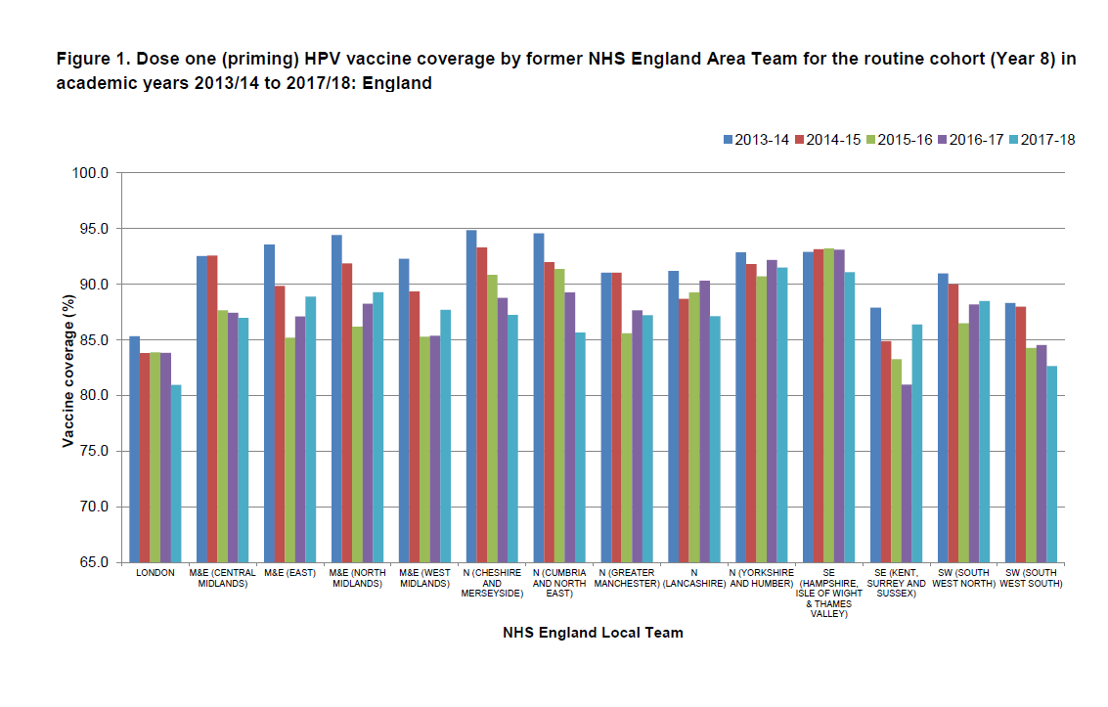
High coverage

Slide 32
An evidence based approach
Setting age intervals
Automation
HPV as the primary screening test

Slide 33
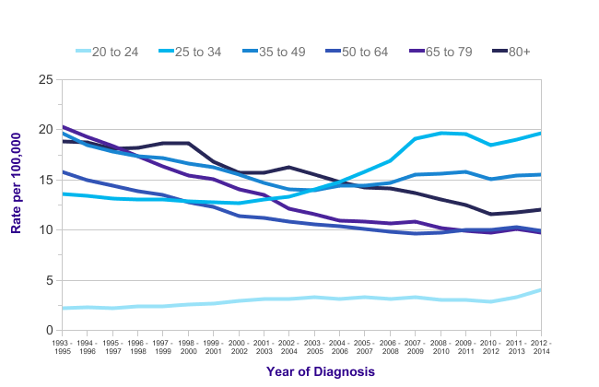

Cervical Cancer (C53): 1993-2014
European Age-Standardised Incidence Rates per 100,000 Population, by Age, Females, UK
Source: cruk.org/cancerstats
You are welcome to reuse this Cancer Research UK statistics content for your own work.
Credit us as authors by referencing Cancer Research UK as the primary source.
Suggested style: Cancer Research UK, full URL of the page, Accessed [month] [year].

Slide 34
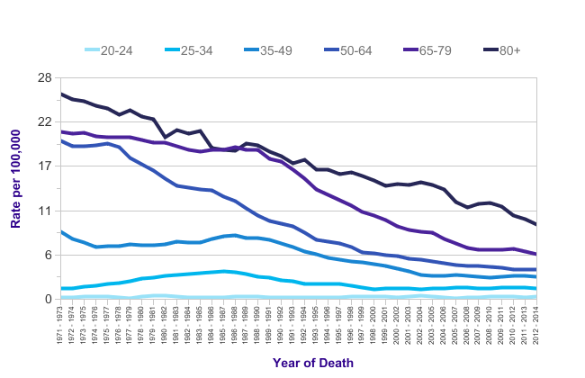
Cervical Cancer (C53): 1971-2014
European Age-Standardised Mortality Rates per 100,000 Population, by Age, Females, UK
Source: cruk.org/cancerstats
You are welcome to reuse this Cancer Research UK statistics content for your own work.
Credit us as authors by referencing Cancer Research UK as the primary source.
Suggested style: Cancer Research UK, full URL of the page, Accessed [month] [year].

Slide 35
Screening in the under 25’s
Original decision made in 2003 on the basis of a harm:benefit analysis
Benefits are limited because
  Cx cancer is very rare in <25’s
  Most at risk women can be detected at age 25
  Evidence is that cx ca in young is not prevented by screening
Harms of screening
  Anxiety++
  Medicalising the well and those with disease which would regress spontaneously.

Slide 36
Jade Goody
Jade Goody was 27 and had been screened from a young age
Died tragically of cervical cancer in 2009
Her death became a focus for demands for the screening age to be lowered
Minister tasked the ACCS to review the evidence to see what if anything had changed since 2003

Slide 37
ACCS review 2009
Evidence supporting starting screening age 25 is even more robust
Policy to remain unchanged
Guidance notes for management of young women with symptoms to be produced

Slide 38
Clinical practice guidelines for the assessment of young women aged 20-24 with abnormal vaginal bleeding
http://www.dh.gov.uk/en/Publicationsandstatistics/Publications/PublicationsPolicyAndGuidance/DH_113478
  A cervical cytology test is not appropriate
  Cervical cancer can present with symptoms but CIN is not symptomatic
  Visual inspection of the cervix with a speculum to exclude established malignancy

Slide 39
Automation
Randomised controlled trial
Mavarik
Automation had a lower sensitivity for an endpoint of CIN2+ compared to cytology primary screening with HPV triage

Slide 40
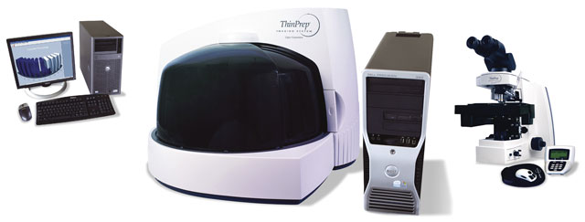
We wont be doing….

Slide 41
Primary Screening for High risk HPV

Slide 42
Any new technique for cervical cancer prevention must demonstrate that it is better than current standard of care

Slide 43
Human papillomavirus (HPV)
High risk (HR) HPV is associated with cervical intraepithelial neoplasia (CIN) and is found in 99.7%* of cervical cancer cases
Persistent infection with HR-HPV is a necessary but insufficient cause of cervical cancer
Persistent HR-HPV infection increases the risk of women developing cervical cancer
Transient HR-HPV infection is common
* Walboomers JM(1), Jacobs MV, Manos MM, Bosch FX. J Pathol. 1999 Sep;189(1):12-9. Human papillomavirus is a necessary cause of invasive cervical cancer worldwide.

Slide 44
ARTISTIC TRIAL
A Randomised Trial In Screening To Improve Cytology
Set up to evaluate the effectiveness of HPV testing in primary cervical screening (Manchester)

Slide 45
ARTISTIC TRIAL
24, 510 women
LBC & HPV test for HR HPV regardless of cytology result

Slide 46
HPV prevalence by age

Slide 47
ARTISTIC
Over 3 screening rounds primary HR-HPV screening:
Showed improved sensitivity compared to liquid based cytology testing
Gave women longer term protection following a negative HR-HPV test result than a normal cytology result

Slide 48
HPV primary screening
Primary HR-HPV testing commenced at 6 English pilot sites in 2013.
The aims of the pilot were to assess:
Feasibility of using primary HR-HPV testing
Clinical protocols for patient management
Acceptability of HR-HPV testing to women
Cost effectiveness

Slide 49
Primary cervical screening with high risk human papillomavirus testing: observational study
Rebolj M; Rimmer J, Denton KJ et al
https://www.bmj.com/content/364/bmj.l240
“This pilot undertaken under routine screening conditions has confirmed that primary hrHPV cervical screening is practicable on a large scale and confers approximately 40% greater sensitivity for cervical intraepithelial neoplasia grade 3 or worse and approximately 30% greater sensitivity for cervical cancer than primary liquid based cytology. This increased detection in a prevalence round was followed by a marked reduction in the incidence after three years, supporting an extension of the screening intervals.”

Slide 50
Approved HPV tests https://www.gov.uk/government/publications/cervical-screening-acceptable-hpv-tests/cervical-screening-acceptable-hpv-tests
Abbott RealTime High-Risk HPV test – m2000 system, TP and SP. Automated pre processing of SP using Tecan Evo also approved.
D Onclarity HPV Test – SP direct from the vial, TP via BD Viper LT system
Cepheid Xpert HPV test -TP on the GeneXpert Dx System or GeneXpert infinity system
Hologic Aptima – using Panther system, TP and SP. Automated TomCat approved but not with new BD lids
Quiagen Hybrid capture II High Risk HPV test – Manual or Rapid Capture, using a 2 RLU cut off. TP and SP. QIAsymphony is only approved for TP
Roche Cobas 4800 HPV System – TP and SP. Manual pre-treatment required for SP. P480 approved
Roche Cobas 6900/8800 systems. TP only. P480 approved to aliquot prior to testing.

Slide 51
HPV Primary Screening Algorithm
All women aged 25-64 on routine call/recall and early recall
HR-HPV Test
HR-HPV -ve
HR-HPV +ve
Routine recall 3y(25-49) 5y(≥50)*
Cytology triage
Cytology normal
Cytology abnormal – borderline or worse
Screen in 2 years#
Colposcopy referral
HR-HPV -ve
HR-HPV +ve
Routine recall 3y(25-49) 5y(≥50)*
Cytology normal
Cytology abnormal – borderline or worse
Screen in 2 years
Colposcopy referral
HR-HPV -ve
HR-HPV +ve
Routine recall 3y(25-49) 5y(≥50)*
Colposcopy referral

Slide 52
HPV Primary Screening Pilot
Colposcopy Management Recommendations
Colposcopy Examination
Inadequate
Normal and adequate
Abnormal
Index test HR-HPV +ve/cytology ≤low grade <40yrs
Index HR-HPV +ve/cytology ≥high grade or ≥40yrs
No biopsy or biopsy <CIN1
Abnormal Biopsy CIN1+
CIN1
≥CIN2
Negative biopsy
Repeat colposcopy in 12m
LLETZ
Index test HR-HPV +ve/ cytology ≤low grade
Index test HR-HPV +ve/cytology ≥high grade
†Recall in 12m
Treat
Discussion at MDT within 2m
Discharge to 3y recall
Discussion at MDT within 2m
HR-HPV -ve
HR-HPV +ve
Discharge to 3y recall
Reflex cytology and/or 12m follow up

Slide 53

Centres for HPV primary screening delivery
Bristol
HSL London
BSPS Chertsey
Derby
Manchester
Gateshead
Norwich
Wolverhampton

Slide 54
Implementation
Target of all women being offered HPV PS by 31.12.19 was met.
Laboratory centralisation was completed by 31.3.20.

Slide 55
Challenges
Coverage
Predicting the future
Effect of COVID-19

Slide 56
Good coverage
It doesn’t matter how good your screening test is if people don’t accept the invitation
Coverage has been falling
Particularly in younger women
Notes:
79.2 % in 2006-07; this is one of the challenges facing the programme
Has changes with Jade Goody
The efectiveness of a programme can also be judged by coverage.
This is the % of women in the target age group who have been screened in the last 5 years
If 80% coverage can be achieved, the evidence suggests that reduction in death rates of 65 to 70%is likely in the long term.
Coverage has doubled from 45 tin 1988-89 to 815 in 2003-03

Slide 57
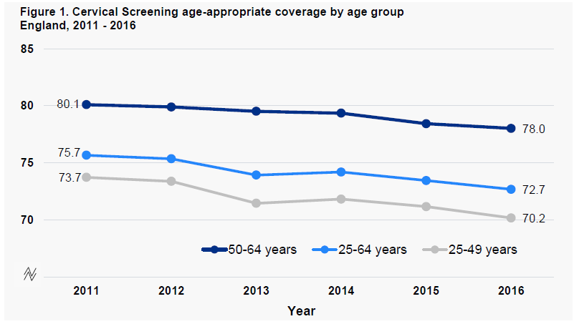
Coverage by age group

Slide 58
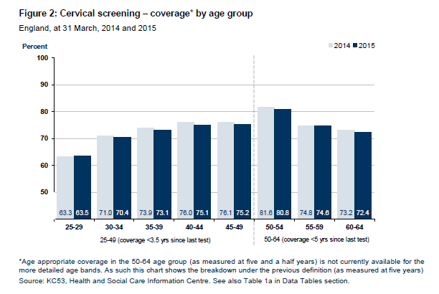
Coverage

Slide 59

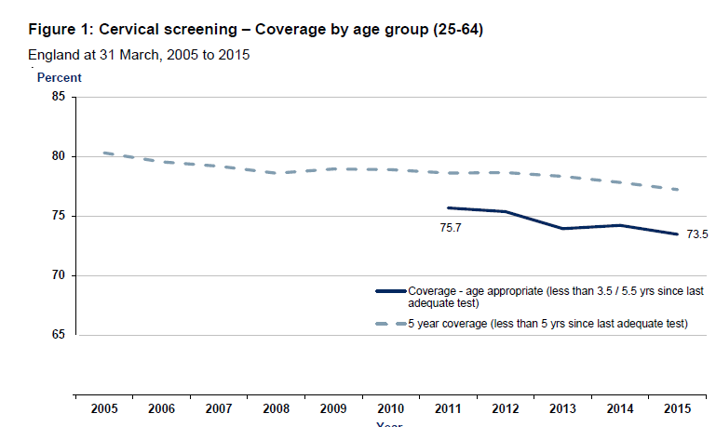
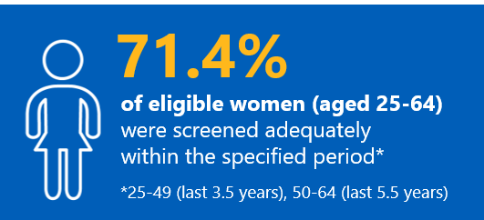

Coverage

Slide 60
Solutions
Public campaigns
HPV self testing?
Good public health initiatives
  Identifying poorly served groups
  Tailored intervention to increase uptake

Slide 61
Modelling the future
Vaccinated population entering screening
Phased implementation of HPV PS
HPV PS reduces incidence of HPV positivity in subsequent rounds
Less CIN3, less treatment, less follow up
Potential screening interval changes

Slide 62
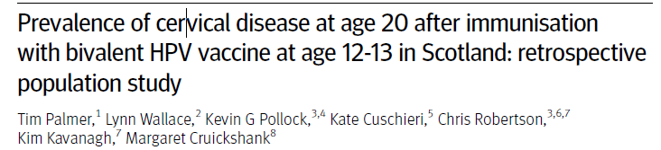
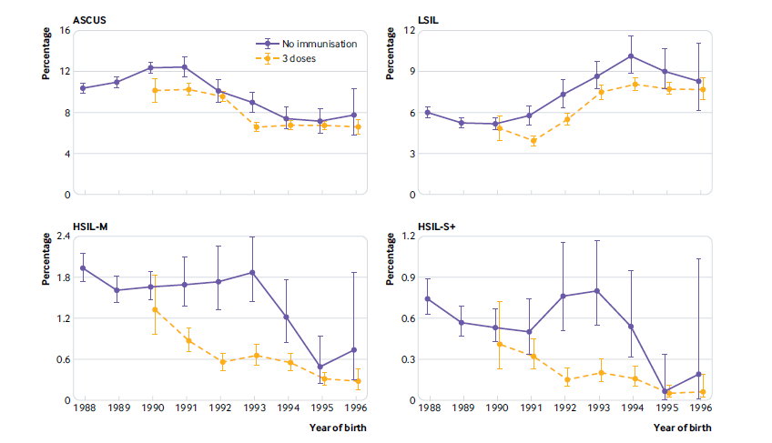
BMJ 2019; 365 doi: https://doi.org/10.1136/bmj.l1161

Slide 63
Effect of COVID-19
From late March 2020 number of women taking up invitation fell dramatically
  Patient choice
  GP appointment availability
New invitations were paused from during May and June but women with an outstanding invitation were able to have samples taken
Paused invitations were issued as a catch up to be complete by September.
National deficit to August approx 750 000 samples
Estimated that laboratory workload will increase by at least 20% during catch up period.

Slide 64
A Major Challenge!
  Will also impact on colposcopy
  Recurrent effect in 3 and 5 years time

Slide 65
Effect on cancer incidence and mortality unknown – more likely to be related to non attendance than short delay in diagnosis.

Slide 66
How does the UK compare internationally?

Slide 67
History of cervical screening in England
Sporadic samples taken since 1950’s
Organised call and recall since 1988
Conventional cytology
  High Inadequate rate (up to 10%)
  Low screening productivity
  Unable to utilise HPV testing
  Could sensitivity be improved?

Slide 68
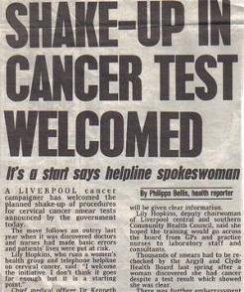
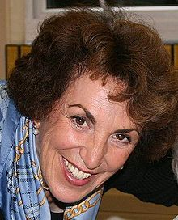
1987
Liverpool Cervical Screening “Scandal”
  Call and recall for cervical screening planned (HC[88]1)
Breast Screening Programme Announced
Daily Express:15 August 2012

Slide 69
Cancer of the Cervix: Death by Incompetence
The Lancet, August 17, 1985
Such inefficiencies are not inevitable. In Finland, Denmark, Iceland, Sweden, and the north-east of Scotland, with similar resources and expenditures, mortality has been cut and continues to fall. Performance in these countries is commensurate with computer predictions of programme-effectiveness with optimum deployment.
The most successful programmes have these points in common:
1. They are organised as public-health cancer-control programmes, specifically directed towards a reduction of mortality; that is their explicit objective. They are not simply laboratory services for providing a clinical investigation.
2. They call the age-groups at greatest and most immediate risk (30 +) and they keep on trying. They concentrate first upon women who have never had a smear at all. They use population registers.
3. Someone is in charge: he/she has a name and a telephone number, and can be held to account.
The failed programmes, as in the UK and Norway, have none of these. Their objectives are stated only in procedural terms (to provide a cytology service) rather than in terms of outcome (to reduce mortality). Procedural objectives do not suggest that anyone should be in overall charge. No-one is.
"Who is in charge of preventing cervical cancer; what is his telephone number; what powers does he have; with what resources will he be provided?"

Slide 70

National Audit Office Report 1992
The emphasis given to quality assurance is a great strength of the breast screening programme and contrasts sharply with the position on the cervical programme

Slide 71

1993 Inverclyde
20,000 smears rescreened after “index case” diagnosed and a new consultant in post
Individual practice
No overall monitoring
Lessons for entire UK

Slide 72
1997: annus horribilis
Kent and Canterbury cervical problems
  8 women died
  30 unecessary hysterectomies
Exeter breast problems
  Affected screening and symptomatic practice
  8 missed diagnoses

Slide 73
Lessons from Kent and Devon
Any national screening programme must operate to national standards
There must be accountability for quality assurance
QA should be separated from management or there is a conflict of interest
Trusts needed clinical as well as financial governance

Slide 74
Cytology
Sensitivity of cervical cytology in the UK is higher than elsewhere
  Evidence
  Athena Trial
    US trial comparing HPV testing and cytology. Cytology sensitivity less than 50%
  Hart Study (mid 90’s)
    Conventional cytology not LBC. UK sensitivity 75%, Germany 35%
  Artistic
    Trial of HPV primary screening vs cytology. Cytology performed much better in the UK than in similar comparisons elsewhere ( Holland, Sweden USA)
Probably due to better specification, training and quality assurance, possibly LBC effect

Slide 75
Models of screening
Organised whole population programme
  National
  State
  UK screening programmes are the best examples
  Also found in Finland, Sweden, Australia, NZ and Canada
Insurance based
  Common European and US model
Opportunistic
  Still the most widespread model

Slide 76
How is it funded
State commissioned, state providers
Private providers, state reimbursement
Insurance
Patient funded

Slide 77
France
Many small labs
No national data collection
Many different lbc/hpv, ? QC on implementation
Low coverage
Low vaccine coverage around 20%

Slide 78
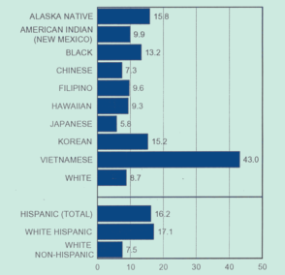
USA
Overall low coverage
Many very vulnerable people uninsured
Major socioeconomic and ethnic variations in uptake
Some eg of good practice
Kaiser Permenante – health maintenance organisation
Very large workflow, good data, QA
Aimed at minimising costs long term therefore great proponents of screening

Slide 79
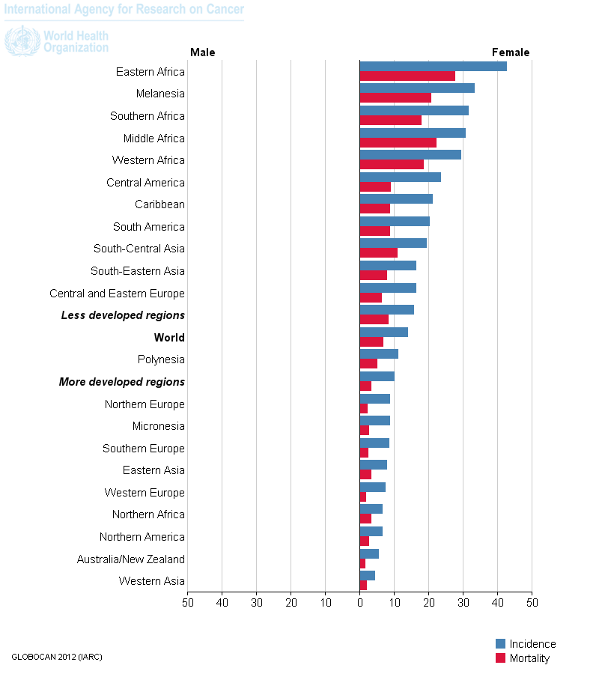
Developing countries
Very high incidence of cervical cancer in some places
Due to high HPV prevalence and in Africa, coincident HIV
Maintaining a cytology based programme is very difficult on every level
Modified protocols eg 1 sample age 35, immediate treatment for all HPV + - not acceptable in developed economies but better than nothing in developing world.

Slide 80
Georgia (Republic of) c 2006
Very interesting development of screening, probably mirrored in many eastern bloc countries
Small number of highly motivated individuals, often trained in US or other high resource setting + Large affluent expat community keen to fund charitable projects in country of origin
= unsustainable LBC/HPV implementation with a population coverage of < 5%
Current situation “ programme delivered to target population in Tblisi”

Slide 81

Cervical Screening in Ireland
Cervical smear tests evolved over many years
Organised screening programme commenced in 2008
State funded
The screening programme organisation is CervicalCheck
Procurement of cytology providers resulted in most of the samples being reported in the USA

Slide 82
May 2018

Slide 83

A patient experience
Vicky Phelan
Diagnosed with cervical cancer in 2014
Brought a successful case against a laboratory for missed abnormalities.
She was awarded substantial damages and refused a non disclosure agreement.
She then went public with her medical records with regards to non disclosure of Audit results

Slide 84

May 2018
The Cabinet agreed to establish a scoping enquiry, chaired by Dr Gabriel Scally

Slide 85
The Scally Review
http://scallyreview.ie/wp-content/uploads/2018/09/Scoping-Inquiry-into-CervicalCheck-Final-Report.pdf
http://scallyreview.ie/wp-content/uploads/2019/06/Supplementary-Report-Final-Master-190607.pdf
In addition a review of the audit by the RCOG was commissioned, to be chaired by Prof Henry Kitchener
  Due later in 2019

Slide 86
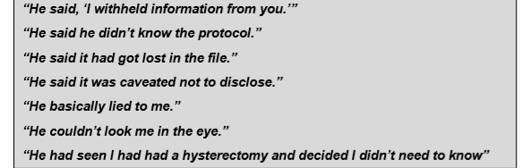
Listening to voices of women
Throughout the report there are quotes from women and their families. They make for very difficult reading.

Slide 87
Recommendations - 50
Women's Health policy in general and access to hospital records
Patient advocates
National screening committee
Public Health Expertise
Revise programme standards
Improved QA specification
Publication and collation of laboratory data allowing comparisons
Epidemiological investigation of any differences

Slide 88
Procurement of laboratory services
Contract governance
Open disclosure
Duty of candour
Cancer registry

Slide 89
International lessons

Slide 90
Questions for cervical screening elsewhere
Does your screening programme put women first?
Quality assurance
  Is your QA process adequately specified, with accountability and governance
  Does it have the data needed to make difficult decisions
  Are you confident it would have picked up the kind of things which were missed in Ireland?

Slide 91
Procurement and commissioning
  Is quality the driving force in procuring laboratory providers?
  Do those doing the procuring have sufficient clinical expertise to judge the bids they receive
  Downstream costs can be…. Significant.
Capacity
  Are there perverse incentives risking quality if capacity is insufficient?
  What are the open and agreed principles for dealing with capacity/demand imbalance
  Just because you think it’s the same doesn’t mean it is

Slide 92
International borders
  Are samples going across borders?
  If so are the governance and accreditation issues fully understood?

Slide 93
Openness and Disclosure?
Does the information women receive reflect the limitations of screening?
Experience in many English labs is that disclosure is offered but only very rarely taken up. Do you have processes in place if this changes?
Are you sure that gynaecologists are offering appropriate disclosure.
Are Duty of Candour guidelines being correctly implemented?

Slide 94
Does your country have duty of candour?
Have you fully examined how it applies to screening programmes
Are you certain that all professionals in all organisations are applying it correctly?

Slide 95
Conclusion
Cervical Cancer Prevention in the UK is already very advanced but improvements have reached a plateau in incidence
Benefits from high uptake vaccination programme are now being realised
Implementation of HPV as a primary screening test complete
Coverage is still an issue
Evidence based approach continues to be used to great effect.

Slide 96
Developments and challenges in the next year
COVID recovery
New national IT system
Interval extension
Self Sampling Evaluation

Slide 97
Cervical Screening is a multidisciplinary, multiagency programme
Touches on fundamental aspects of medical practice across disciplines
UK cervical screening is the best in the world but no room for complacency

Slide 98
Useful resources
https://www.gov.uk/topic/population-screening-programmes/cervical
http://www.britishcytology.org.uk/

