Slide 1

St Mark’s Hospital & Academic Institute
GASTROINTESTINAL HISTOPATHOLOGY
LECTURES
Dr M Moorghen

Slide 2
GASTROINTESTINAL
PATHOLOGY
1
Introduction to
OESOPHAGUS AND STOMACH

Slide 3


CURRICULUM FOR SPECIALTY TRAINING IN HISTOPATHOLOGY
2015

Slide 4
NORMAL HISTOLOGY
HISTOPATHOLOGY
(Biopsy pathology)

Slide 5
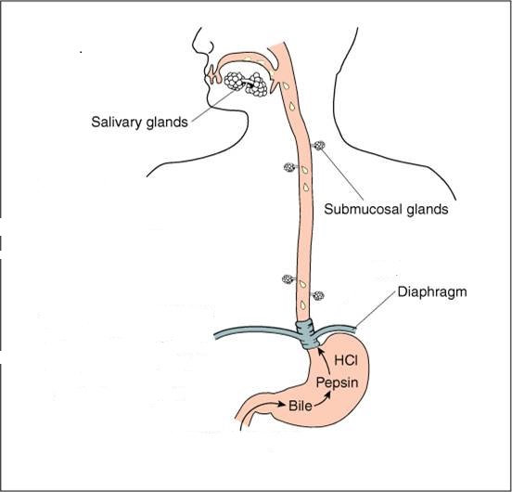

Slide 6
GUT LINING EPITHELIUM
COLUMNAR
SQUAMOUS

Slide 7
SQUAMOUS EPITHELIUM: MOUTH
ANAL CANAL
COLUMNAR EPITHELIUM: ELSEWHERE

Slide 8
OESOPHAGUS

Slide 9
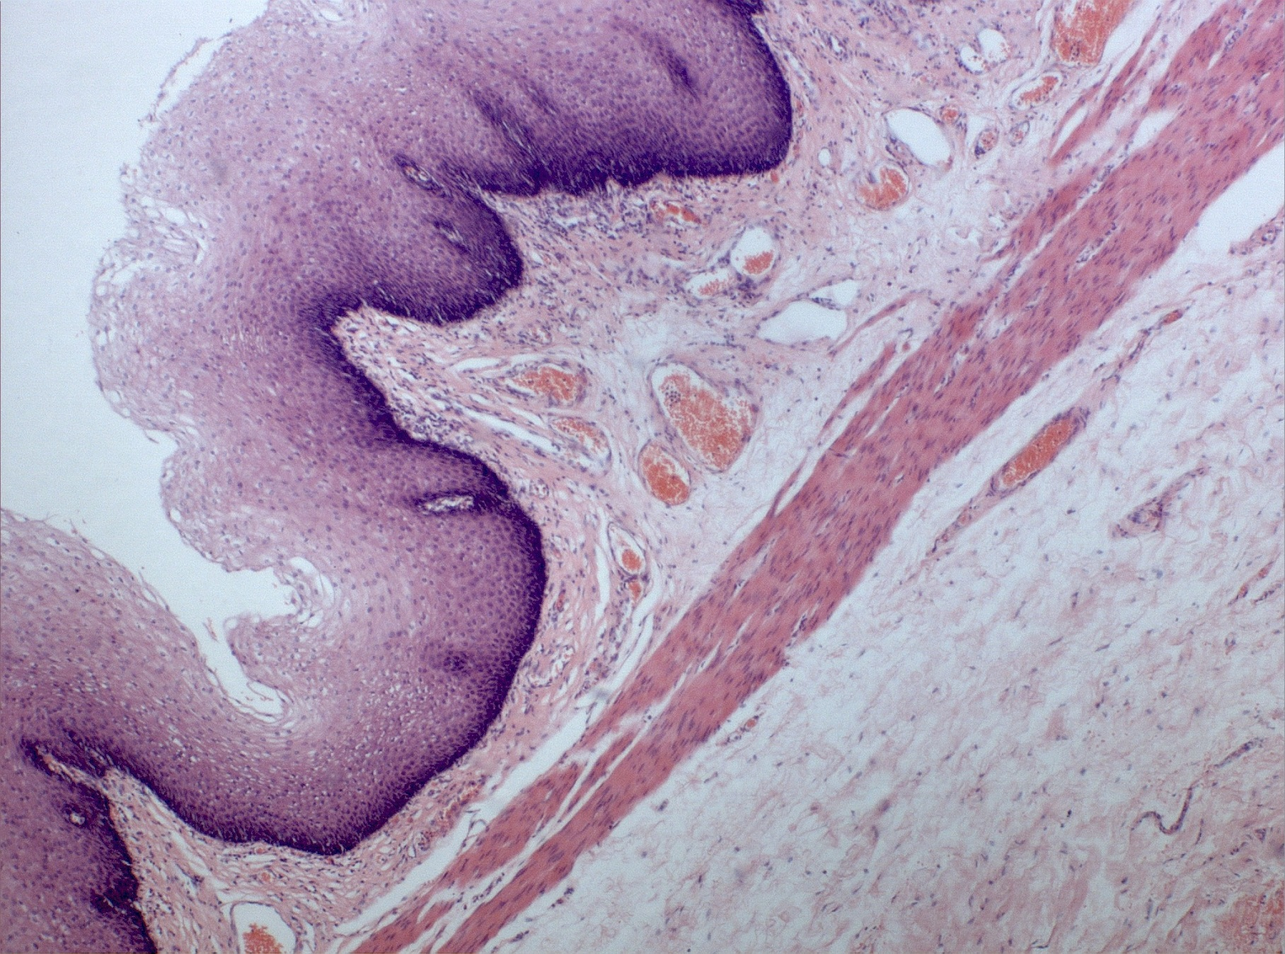
muscularis mucosae
OESOPHAGUS

Slide 10
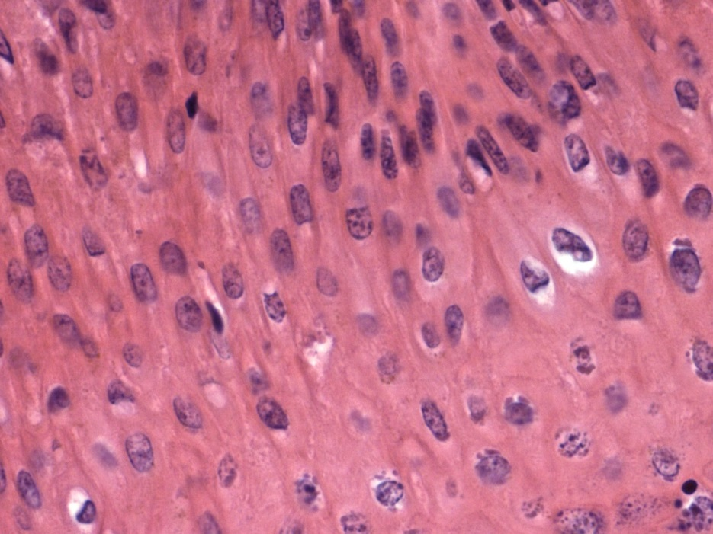

Squamous Pavement

Slide 11
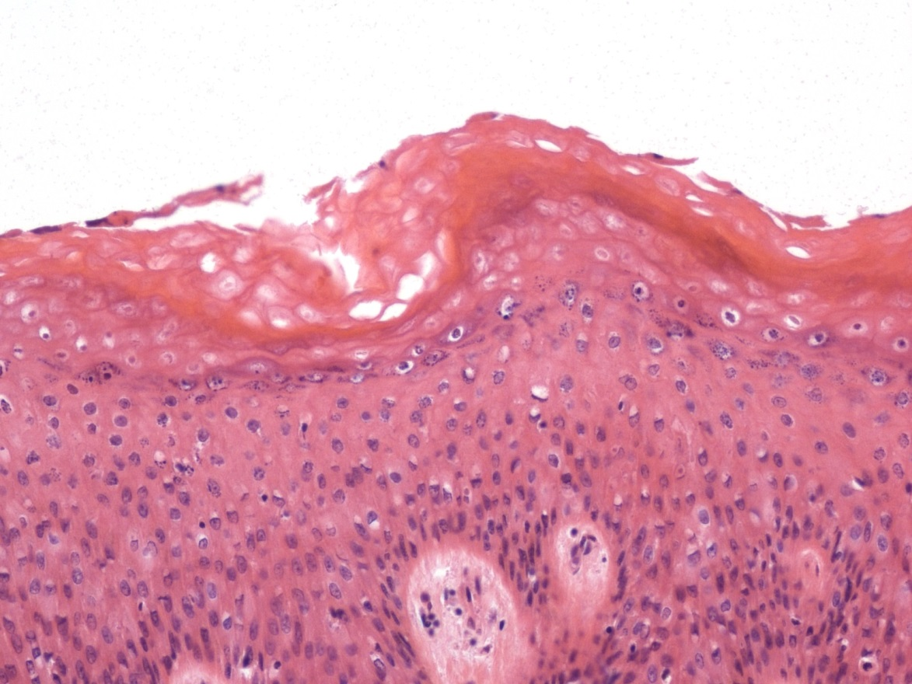
SKIN

Slide 12
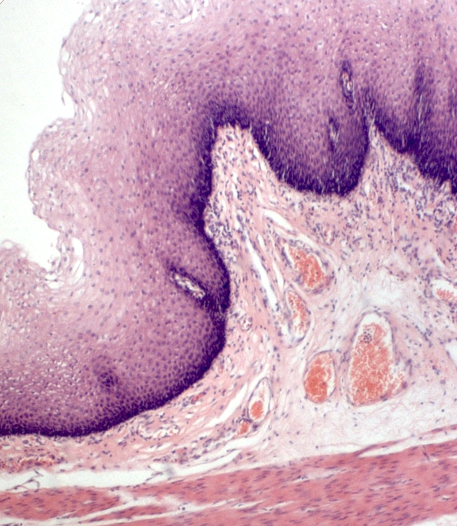
OESOPHAGUS

Slide 13
STOMACH

Slide 14
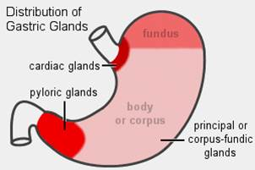

Slide 15
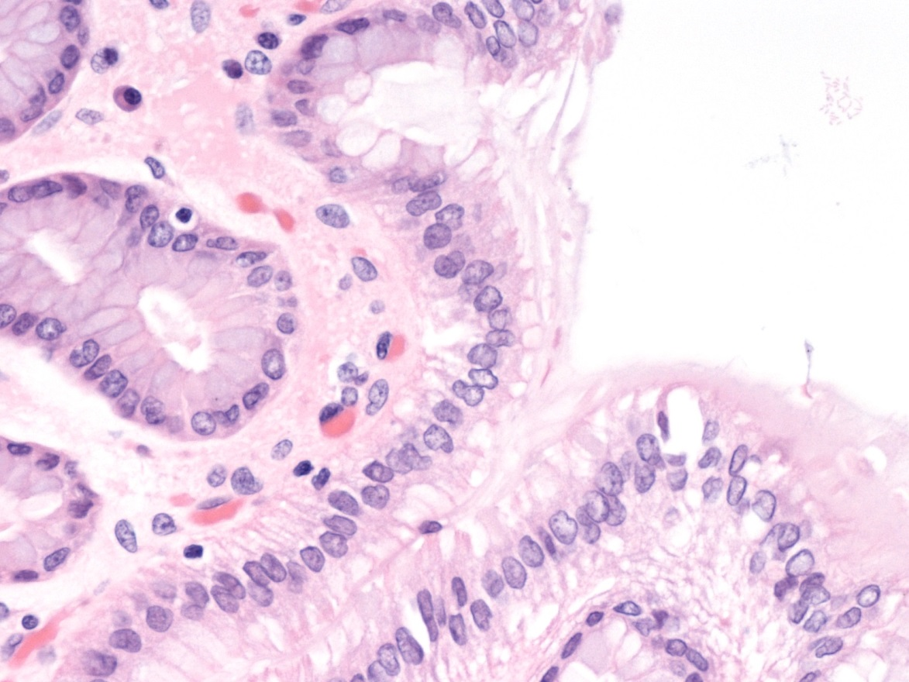
PIT

Slide 16
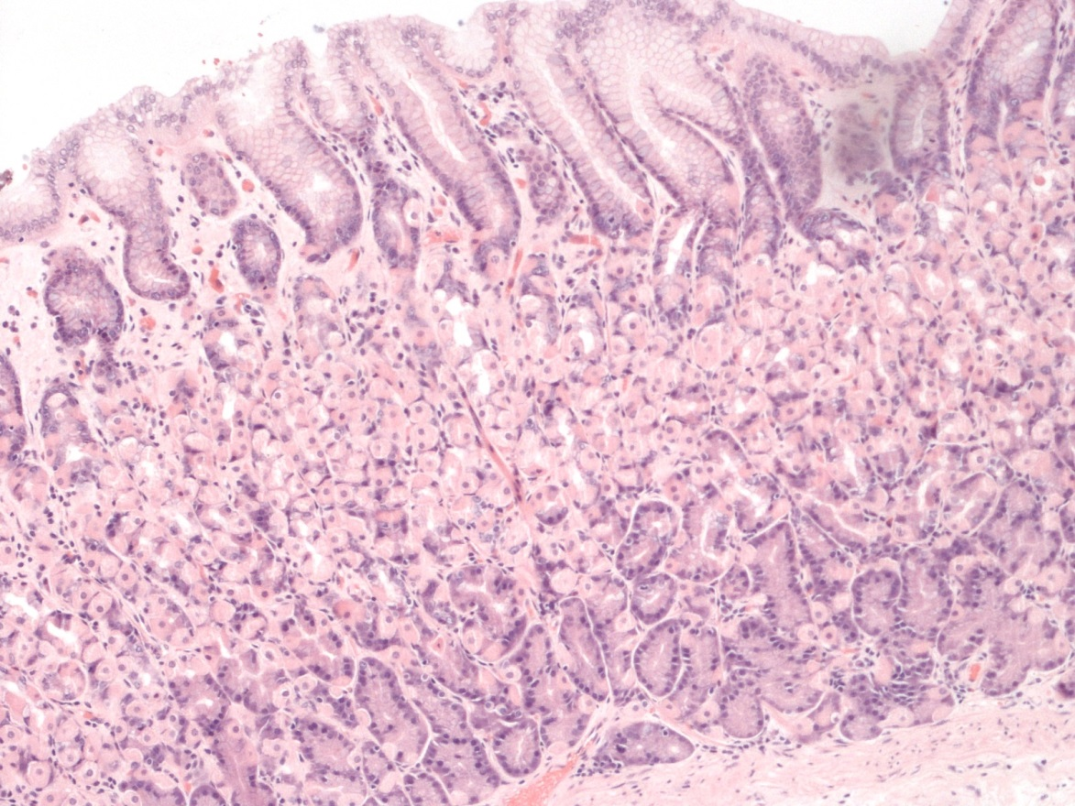
pit
P
C

Slide 17
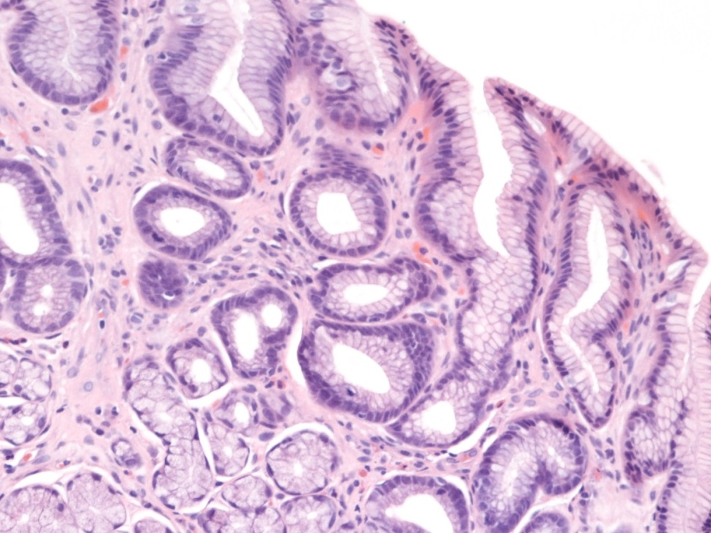
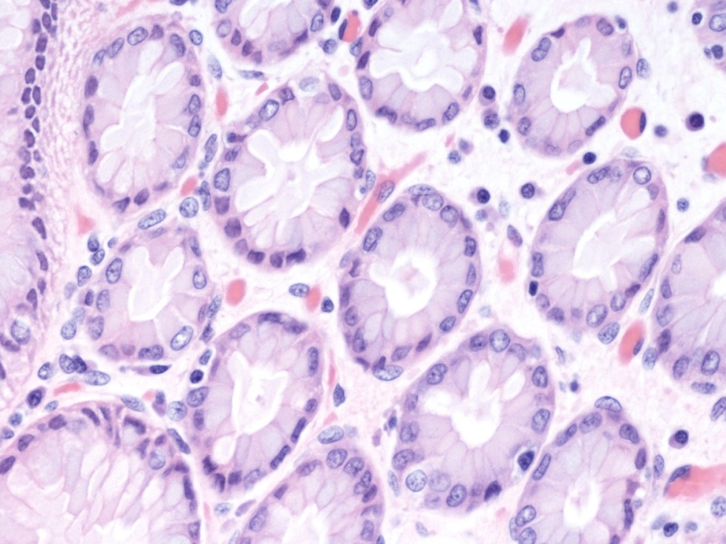
ANTRUM

Slide 18
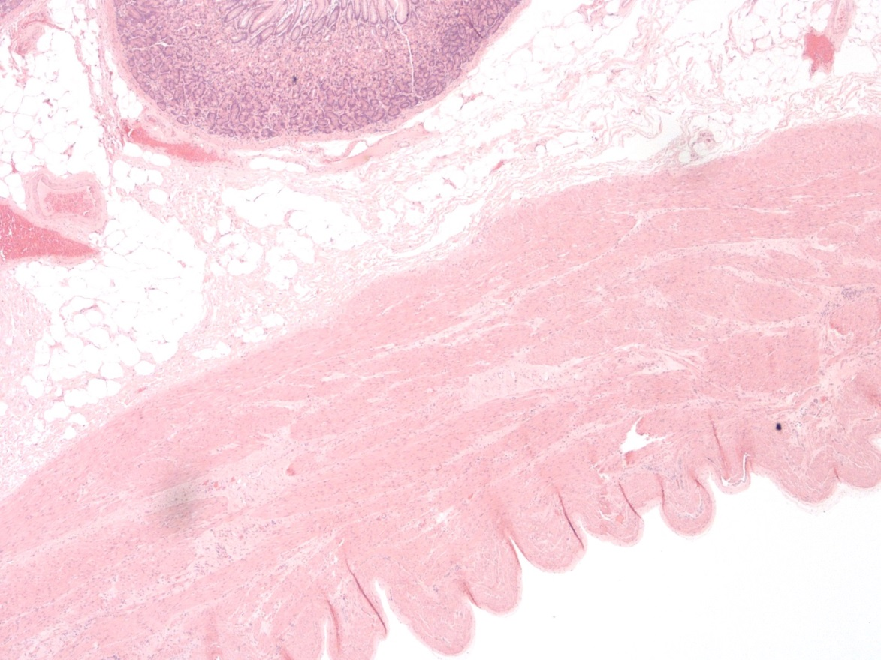
SUBMUCOSA
MUSCULARIS PROPRIA

Slide 19
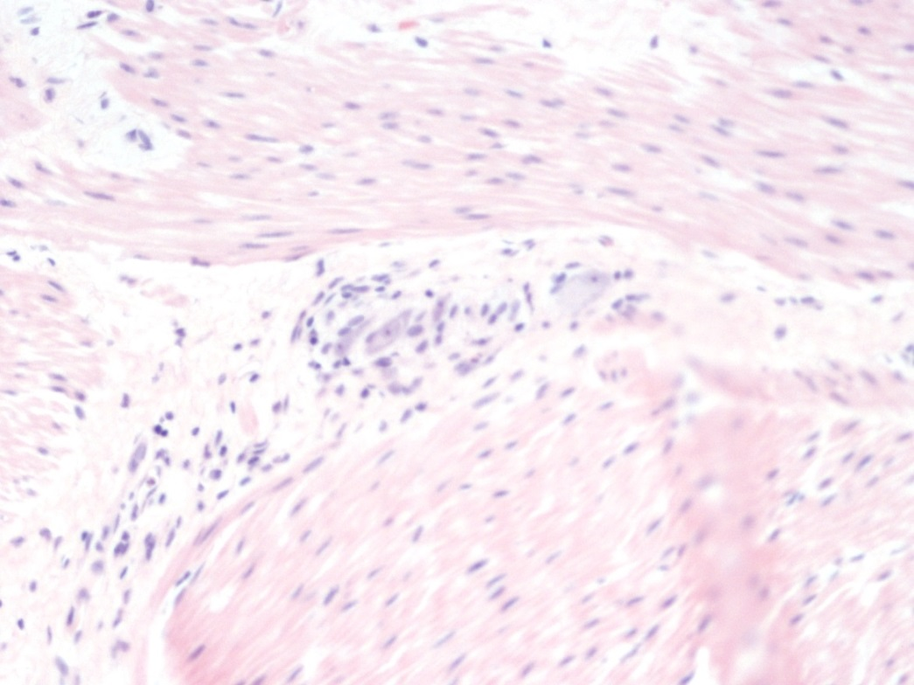
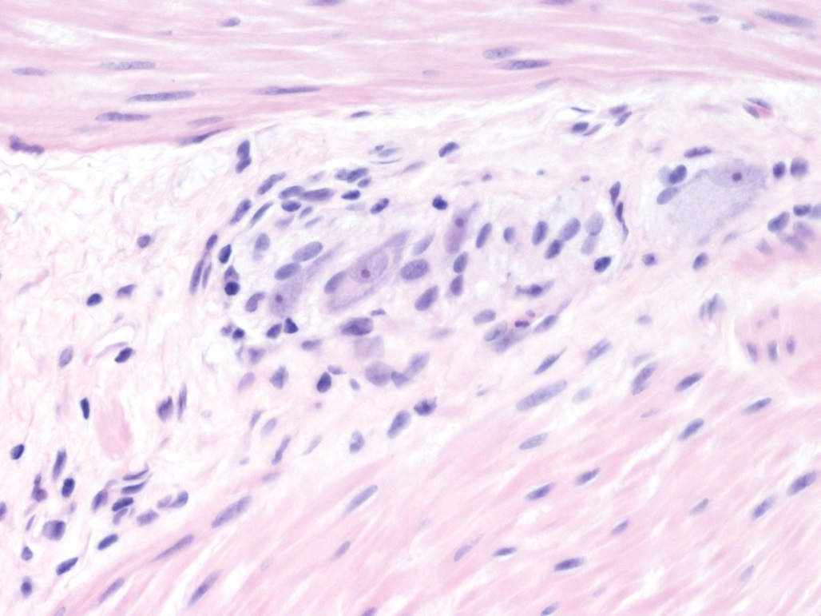
G
MYENTERIC PLEXUS

Slide 20
OESOPHAGUS AND STOMACH
HISTOPATHOLOGY

Slide 21
OESOPHAGUS
REFLUX
BARRETT’S OESOPHAGUS
EOSINOPHILIC OESOPHAGITIS
CARCINOMA

Slide 22
REFLUX/ GORD/ GERD
DEFINITION – based on symptoms
ENDOSCOPY: NORMAL
EROSIVE
NON-EROSIVE

Slide 23
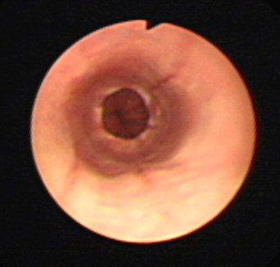
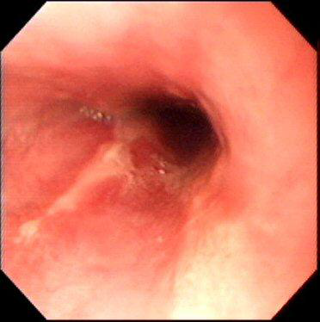
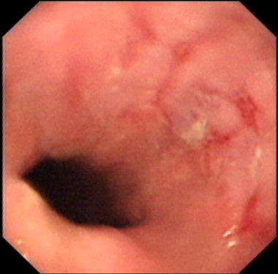
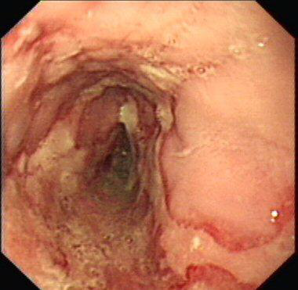
B
A
C
D

Slide 24
GORD- ROLE OF HISTOLOGY
Correlate with endoscopic findings
Consider other diagnoses:
eg EOSINOPHILIC OESOPHAGITIS
Candidiasis
BARRETT’S OESOPHAGUS
???NEOPLASIA

Slide 25
REFLUX
HISTOLOGY
BASAL HYPERPLASIA (>15%)
ELONGATION OF PAPILLAE (>2/3)
EOSINOPHILS/ NEUTROPHILS
CAPILLARY CONGESTION
(Gastroenterology 1970 58: 163-174)

Slide 26
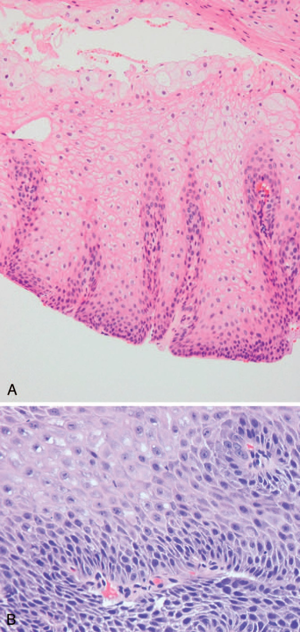
ELONGATION OF PAPILLAE
BASAL HYPERPLASIA

Slide 27
BARRETT’S OESOPHAGUS

Slide 28
DEFINITION
▸ Barrett’s oesophagus is defined as an oesophagus in which any portion of the normal distal squamous epithelial lining has been replaced by metaplastic columnar epithelium, which is clearly visible endoscopically (≥1 cm) above the GOJ and confirmed histopathologically from oesophageal biopsies
www.bsg.org.uk

Slide 29
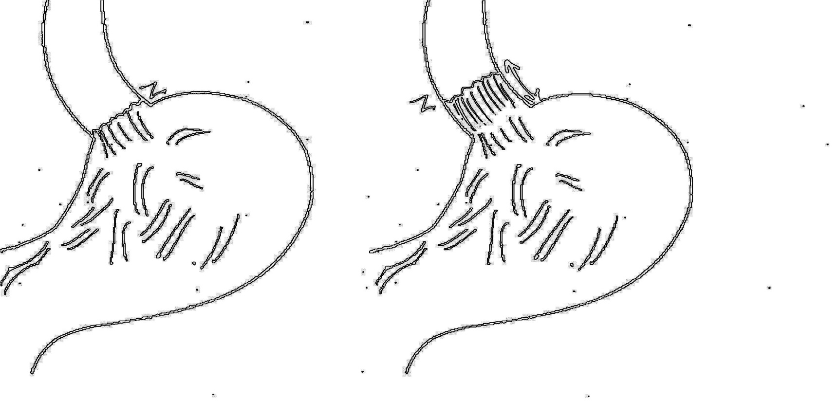
NORMAL BARRETT’S

Slide 30
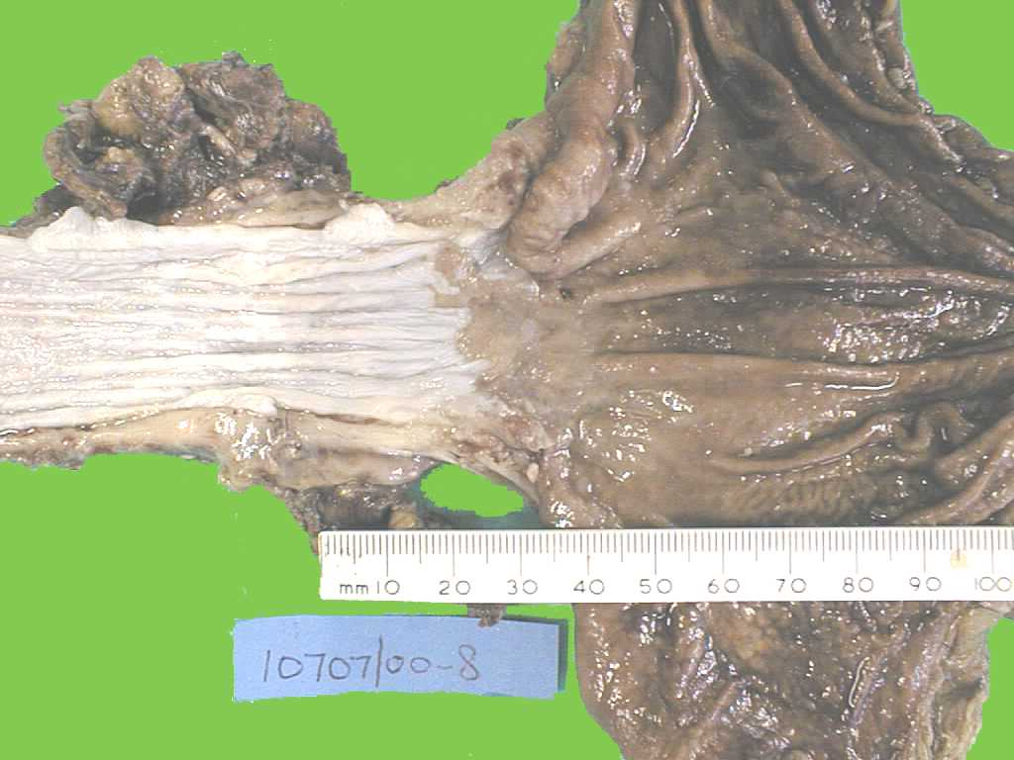

Slide 31
? METAPLASIA

Slide 32
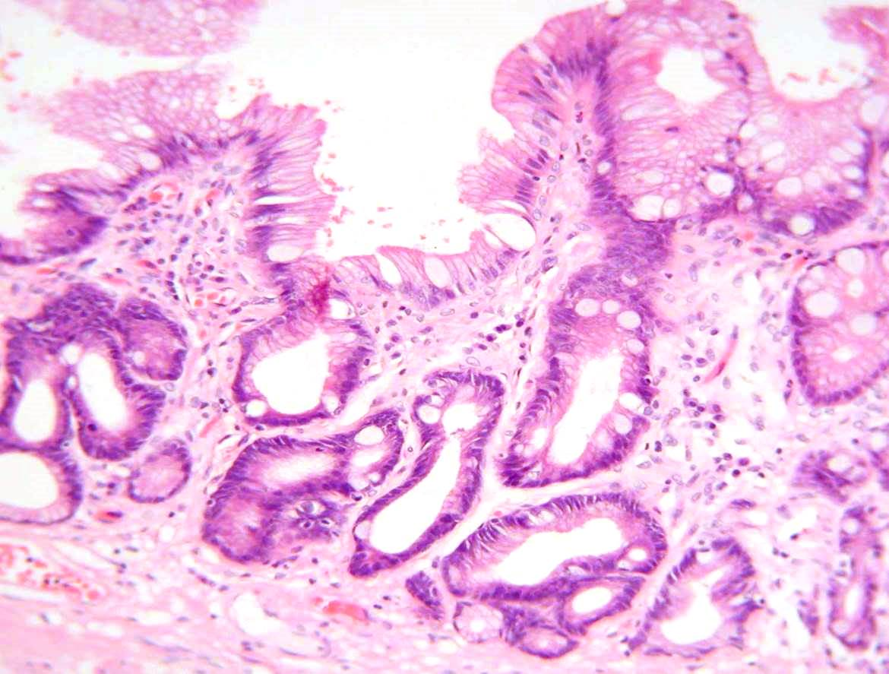
BARRETT’S METAPLASIA

Slide 33
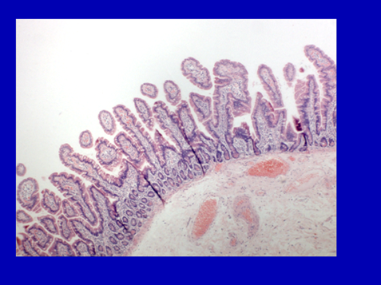
Normal small bowel

Slide 36
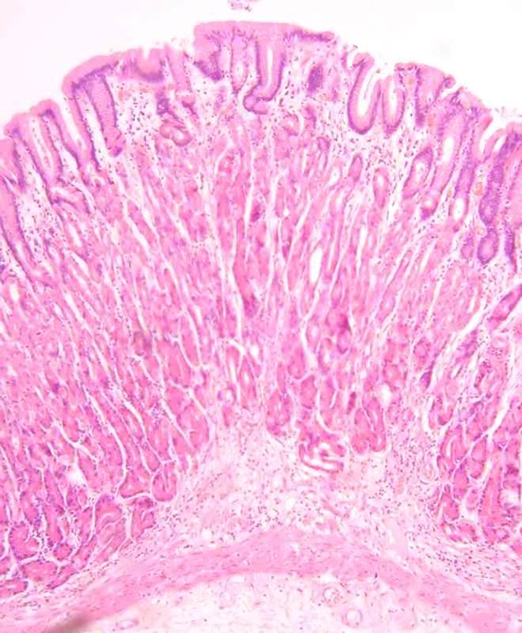
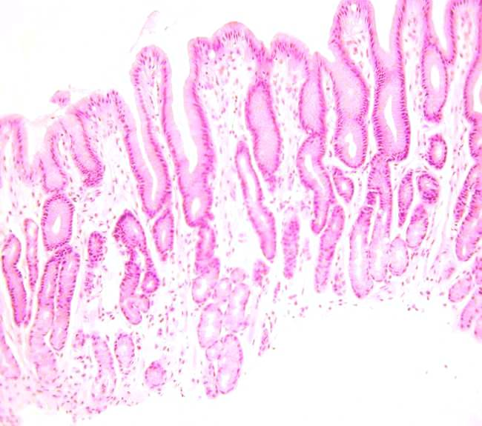

Slide 37
BARRETT’S MUCOSA (METAPLASIA)
DYSPLASIA (LOW GRADE)
DYSPLASIA (HIGH GRADE)
ADENOCARCINOMA

Slide 38
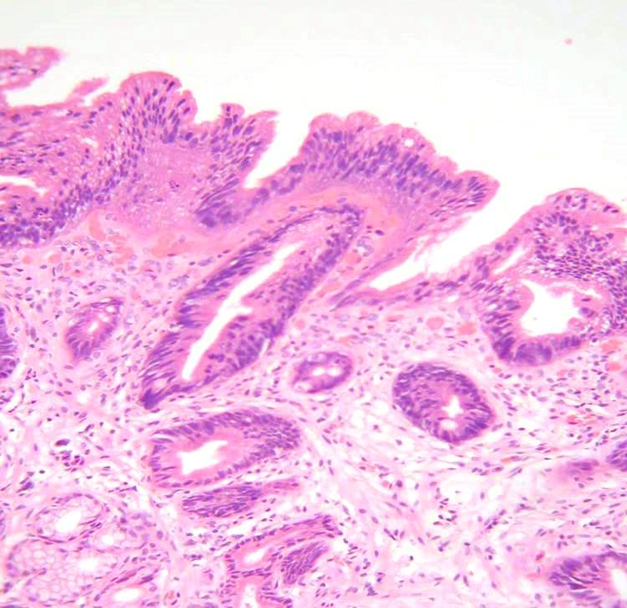
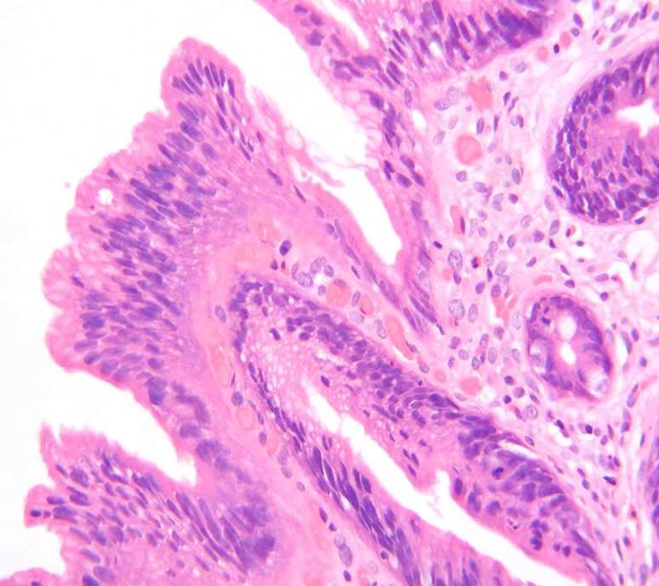
LOW GRADE DYSPLASIA

Slide 39
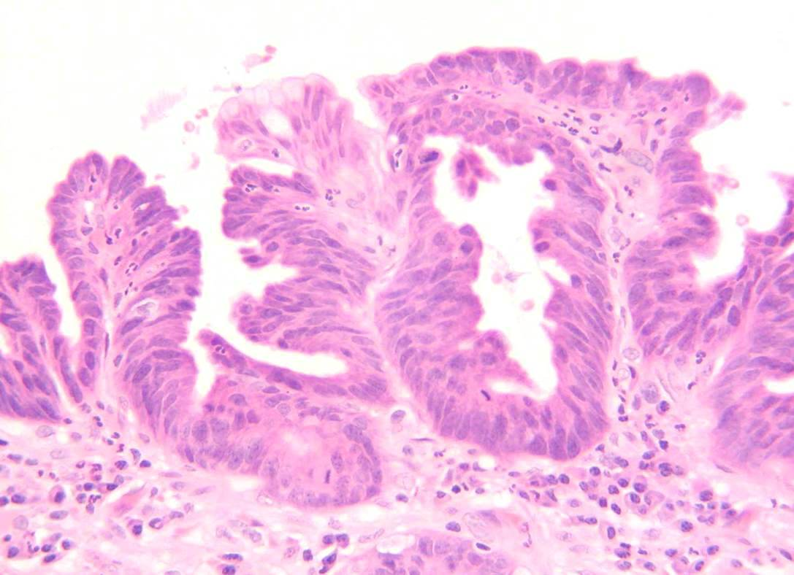
HIGH GRADE DYSPLASIA

Slide 40
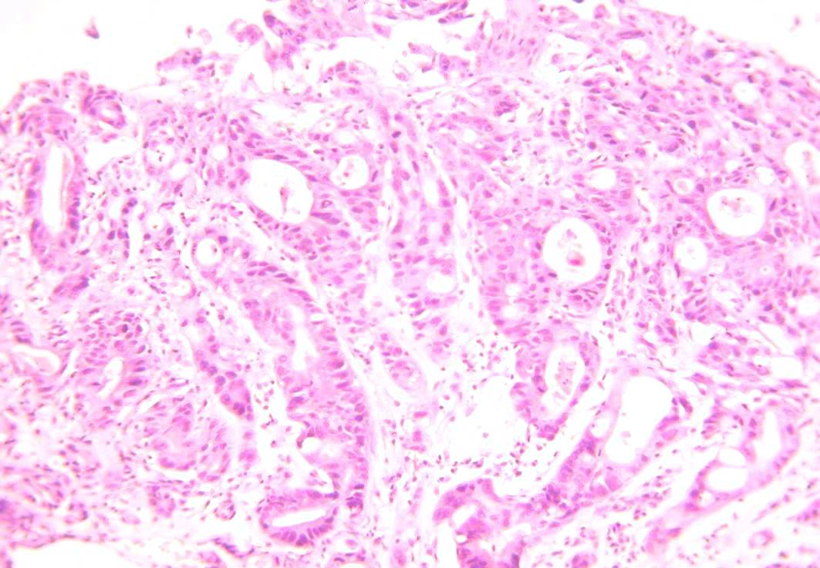
ADENOCARCINOMA

Slide 41
DEFINITION
▸ Barrett’s oesophagus is defined as an oesophagus in which any portion of the normal distal squamous epithelial lining has been replaced by metaplastic columnar epithelium, which is clearly visible endoscopically (≥1 cm) above the GOJ and confirmed histopathologically from oesophageal biopsies
www.bsg.org.uk

Slide 42
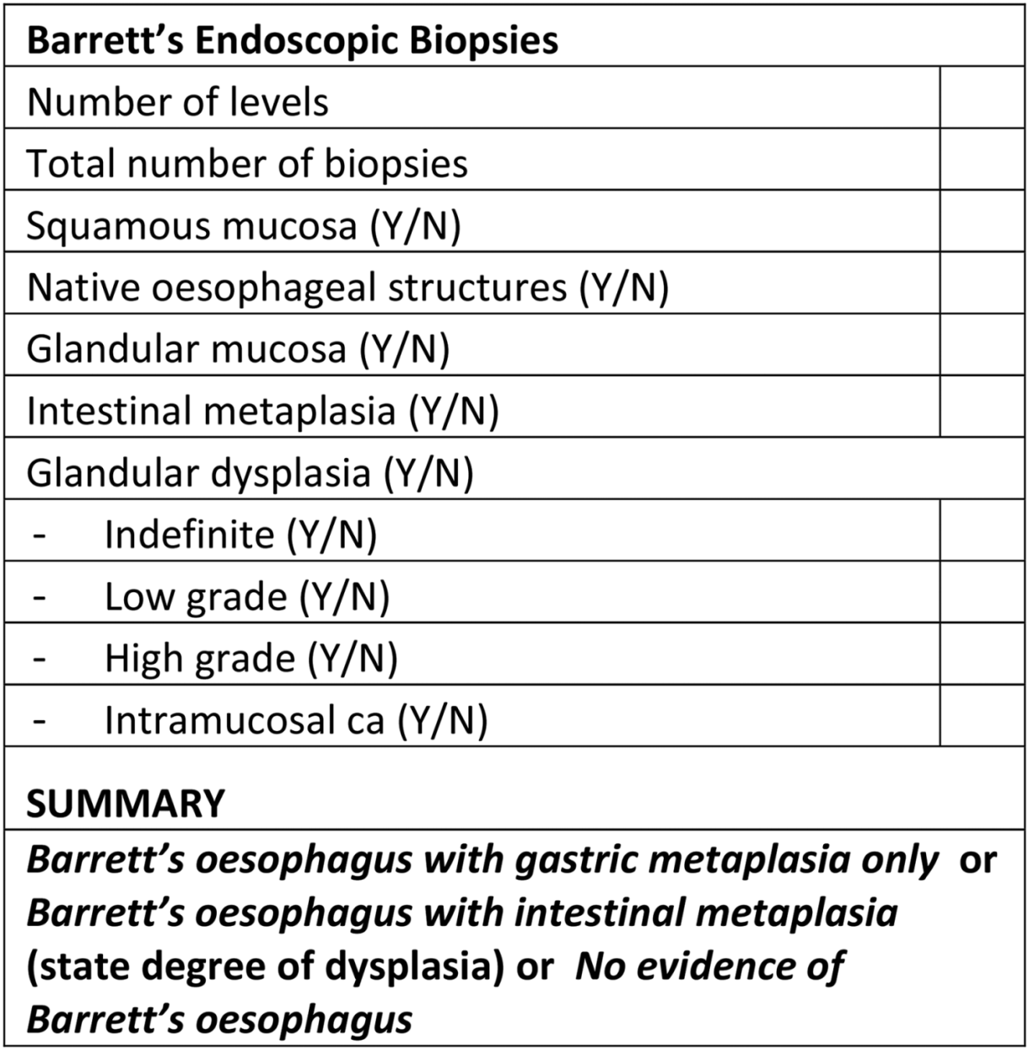
WWW.bsg.org.uk

Slide 43
EOSINOPHILIC OESOPHAGITIS

Slide 44
Eosinophilic oesophagitis
“ chronic, immune-mediated, .. oesophageal dysfunction ….characterised by eosinophil-rich inflammation”

Slide 45
EOSINOPHILIC OESOPHAGITIS
DIAGNOSIS
CLINICAL
ENDOSCOPY
HISTOLOGY

Slide 47
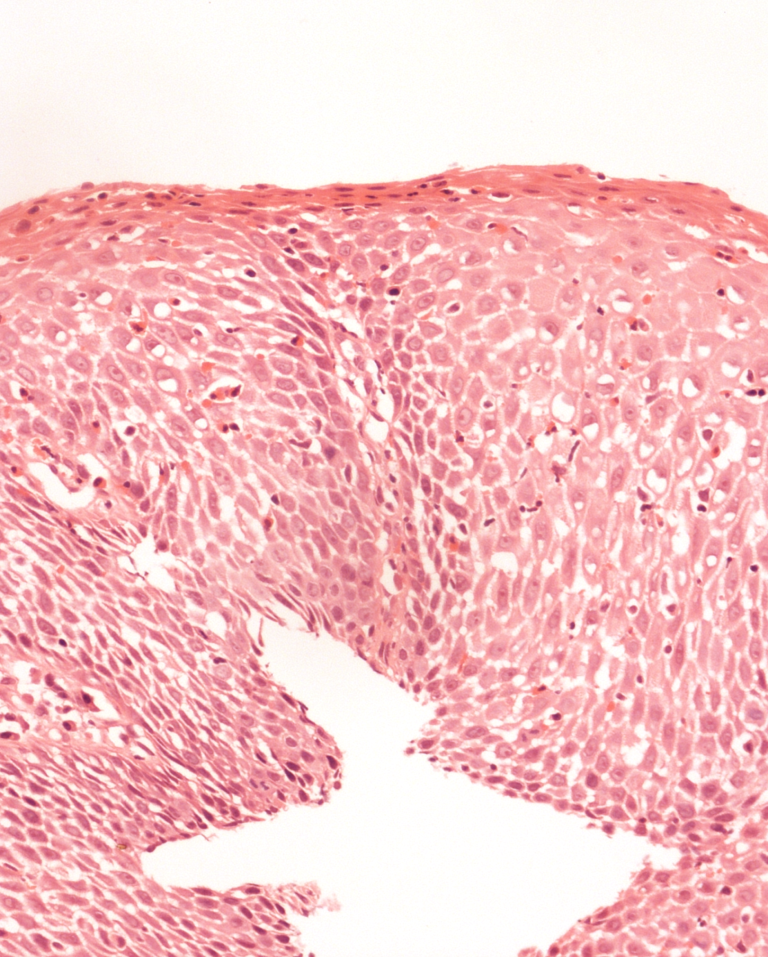
OEDEMA
INFLAMMATION
HISTOLOGY:
14 EOSINOPHILS/HPF

Slide 48
OESOPHAGEAL CARCINOMA
WHO CLASSIFICATION 2019
SQUAMOUS CARCINOMA
( verrucous, spindle cell, basaloid)
ADENOCARCINOMA
(ADENOID CYSTIC, ADENOSQUAMOUS,
MUCOEPIDERMOID),
UNDIFFERENTIATED
NEUROENDOCRINE (NET AND NEC) AND
MIXED (MiNEN)

Slide 49
OESOPHAGEAL TUMOURS
NON-EPITHELIAL
MESENCHYMAL eg GIST
LYMPHOMAS

Slide 50
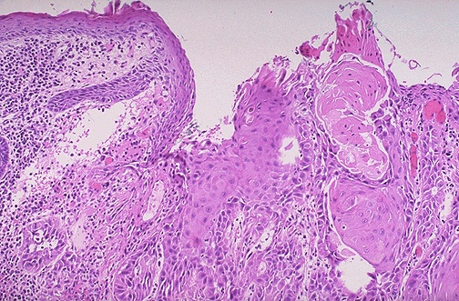
Oesophageal SCC
WELL DIFFERENTIATED

Slide 51
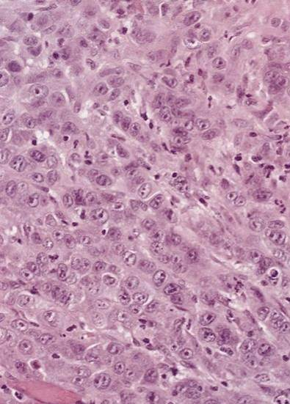
Oesophageal SCC
POORLY DIFFERENTIATED

Slide 52
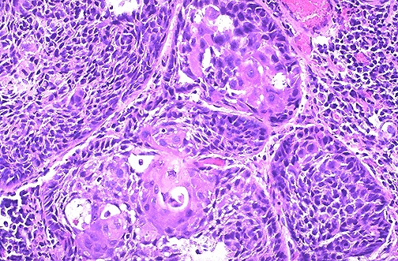
Oesophageal SCC
MODERATELY DIFFERENTIATED

Slide 53
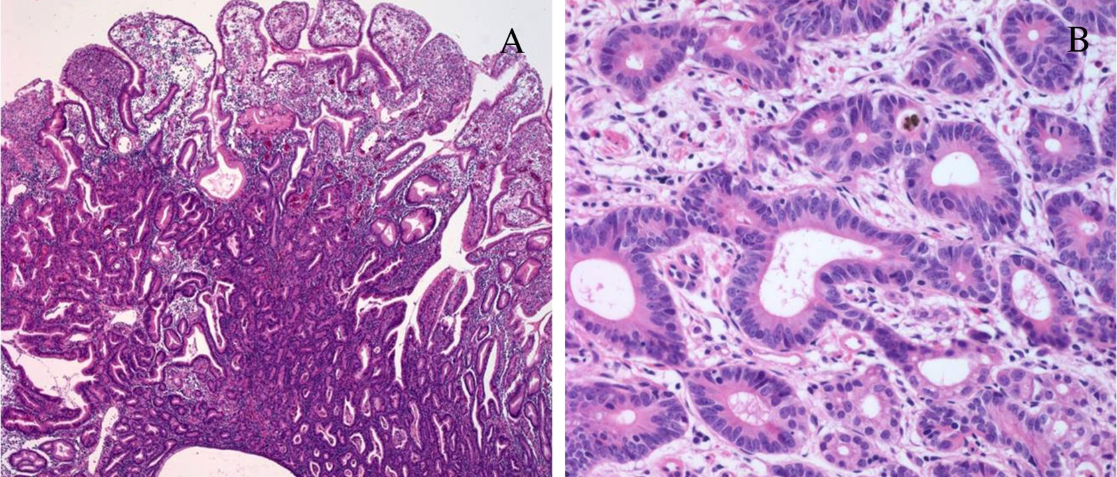
Oesophageal adenocarcinoma
WELL DIFFERENTIATED

Slide 54
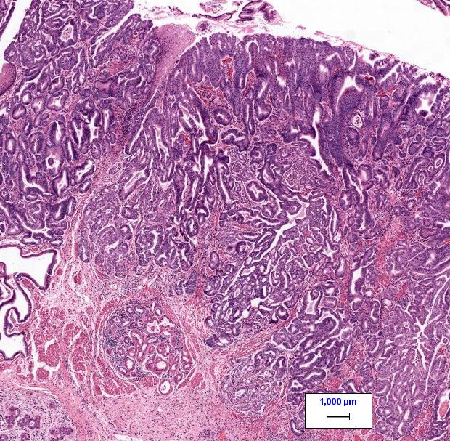
OESOPHAGEAL ADENOCARCINOMA
MODERATELY DIFFERENTIATED

Slide 55
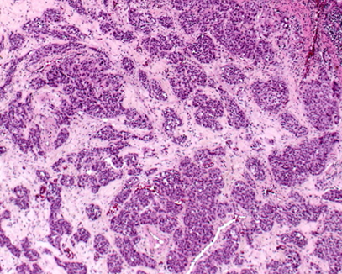
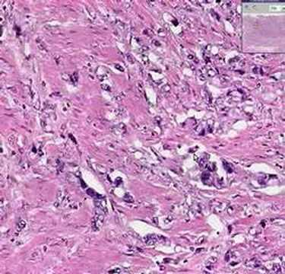
OESOPHAGEAL ADENOCARCINOMA
POORLY DIFFERENTIATED

Slide 56


STOMACH

Slide 57
STOMACH
GASTRITIS
GASTRIC POLYPS
GASTRIC TUMOURS

Slide 58
GASTRITIS
ACUTE: NSAID, STRESS, ALCOHOL
CHRONIC: A- AUTO-IMMUNE
B- BACTERIAL
C- CHEMICAL

Slide 59
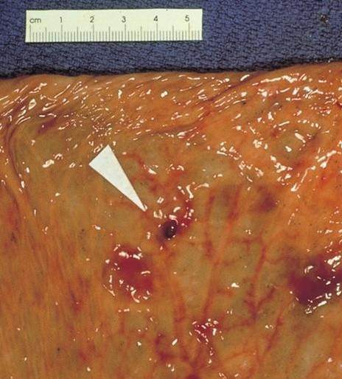
ACUTE GASTRITIS
EROSIONS

Slide 60
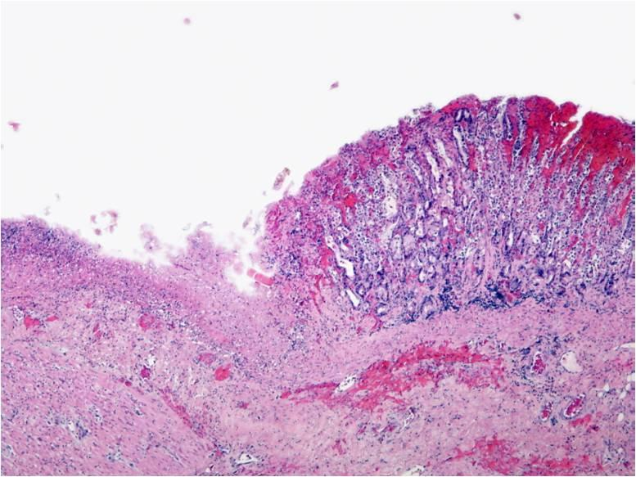

Slide 61
GASTRITIS
ACUTE
CHRONIC A
B
C

Slide 62
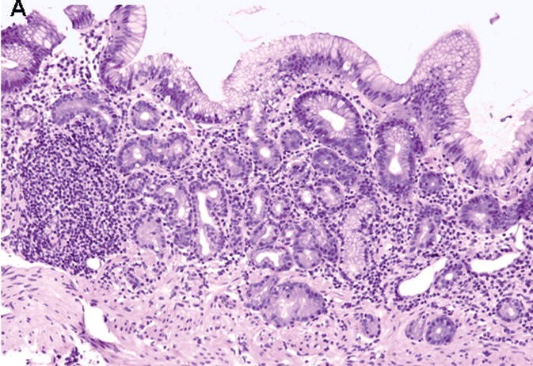
A
CHRONIC ATROPHIC GASTRITIS

Slide 63
CHRONIC ATROPHIC GASTRITIS
CHRONIC AUTOIMNUNE ATROPHIC
GASTRITIS

Slide 64
B
CHRONIC GASTRITIS
HELICOBACTER PYLORI

Slide 65
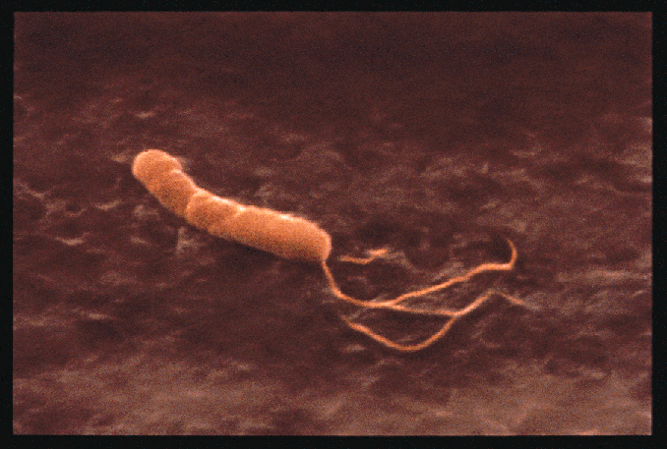
HELICOBACTER PYLORI

Slide 67
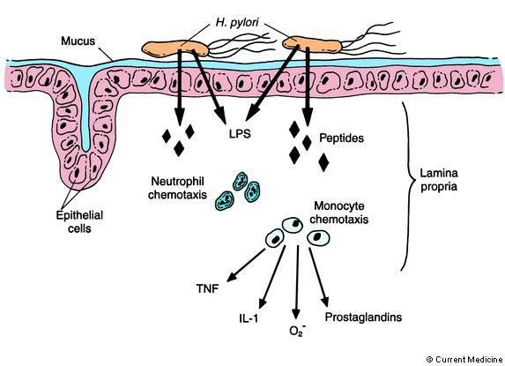

Slide 68
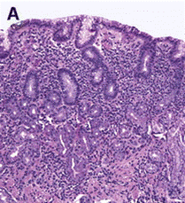

Slide 69
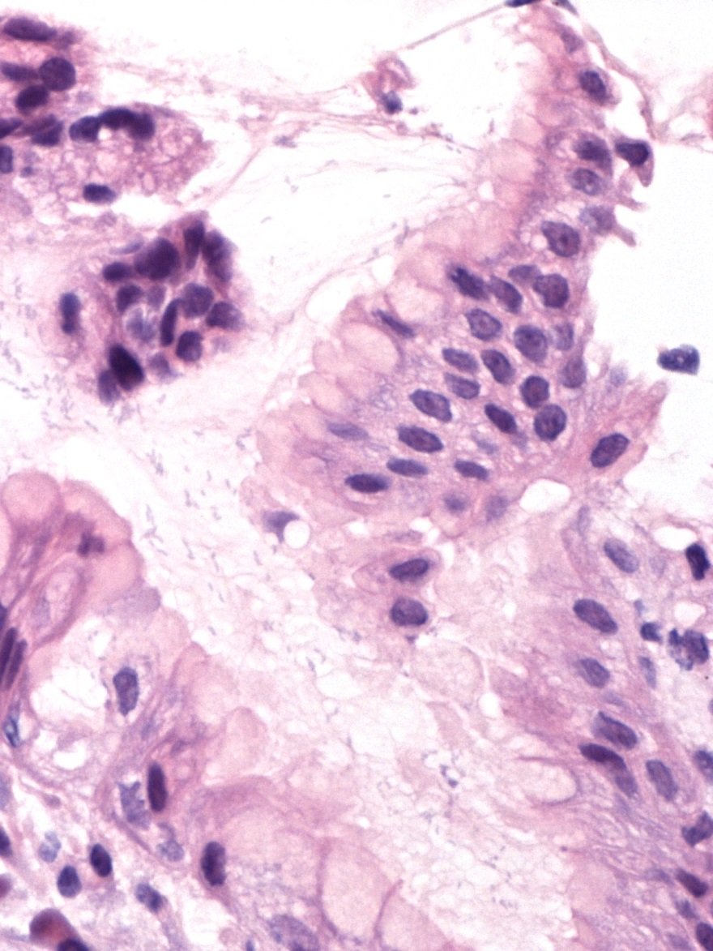
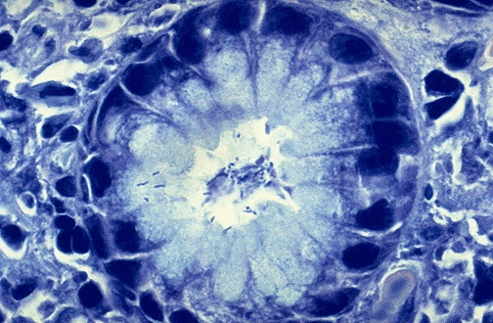

Slide 70
HISTOLOGY REPORT
TYPE OF MUCOSA: BODY/ ANTRAL
HELICOBACTER PYLORI: PRESENT OR NOT
CHRONIC INFLAMMATION: MILD/ MOD/ SEVERE
ACTIVE INFLAMMATION: MILD / MODERATE/ SEVERE
INTESTINAL METAPLASIA
ATROPHY

Slide 71
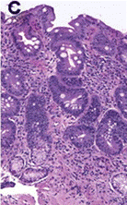

Slide 72
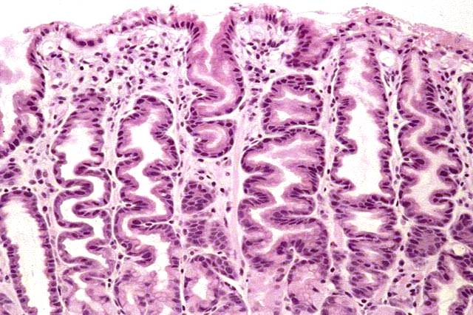
C
REACTIVE GASTRITIS/ GASTROPATHY

Slide 73
GASTRIC POLYPS
FUNDIC GLAND CYST POLYPS
HYPERPLASTIC POLYP
ADENOMA
HAMARTOMAS

Slide 74
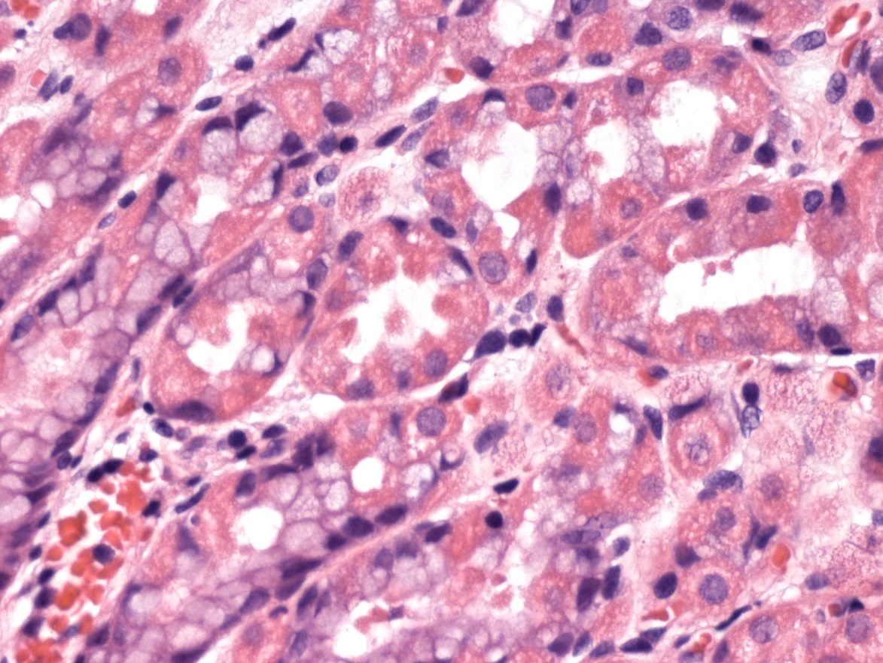
PARIETAL CELL HYPERPLASIA

Slide 75
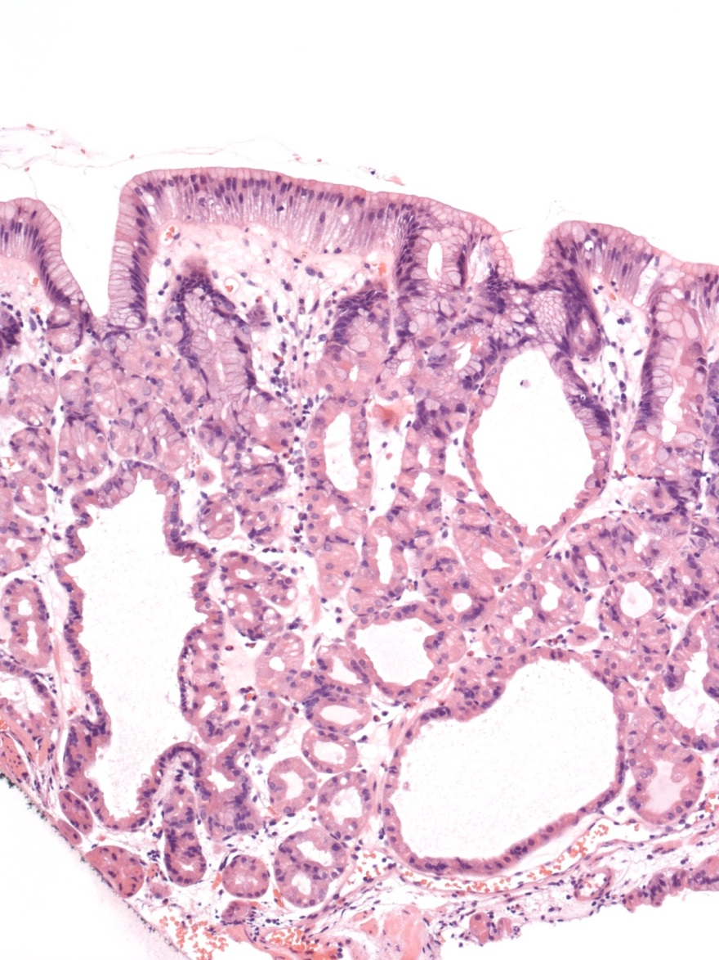
FUNDIC GLAND CYST POLYP

Slide 76
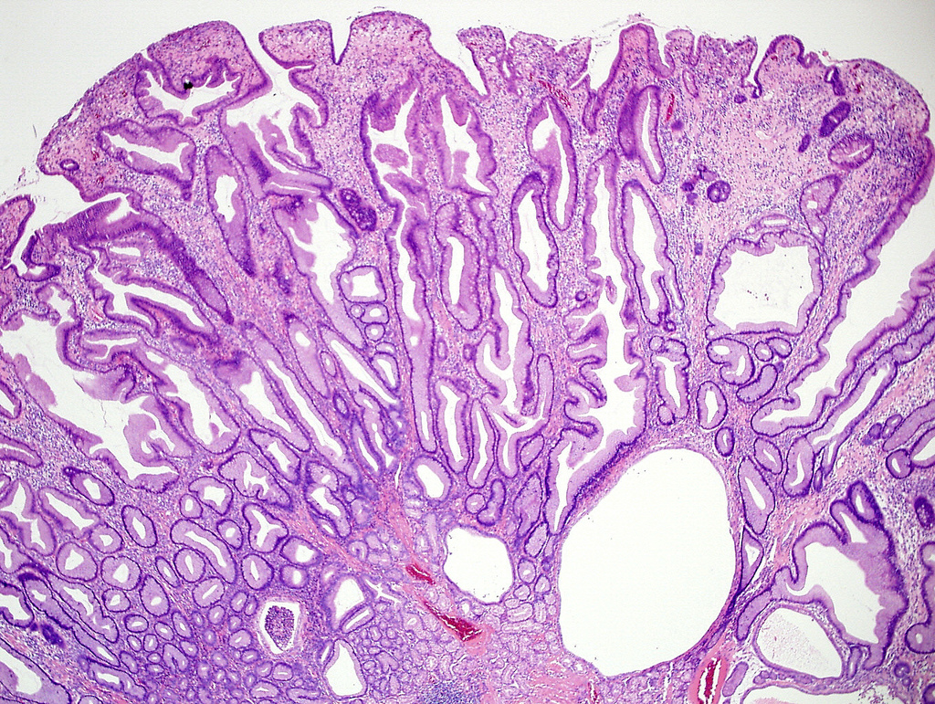
Hyperplastic gastric polyp

Slide 78

GASTRIC ADENOMA
Low grade dysplasia

Slide 79
Gastric adenocarcinoma

Slide 80
CLASSIFICATION OF GASTRIC ADENOCARCINOMA
WHO CLASSIFICATION (2019)
JAPANESE GASTRIC CANCER ASSOCIATION
LAUREN CLASSIFICATION
OTHER/S
MOLECULAR CLASSIFICATION (FUTURE)

Slide 81
GASTRIC TUMOURS
WHO CLASSIFICATION 2019
EPITHELIAL TUMOURS
Benign Epithelial tumours: adenoma
Malignant Epithelial tumours: adenocarcinoma (
Tubular, Papillary, Parietal, Signet ring, poorly cohesive, medullary,
Hepatoid.
Neuroendocrine tumours (NET and NEC)

Slide 82
Lauren classification
INTESTINAL
DIFFUSE

Slide 83

WHO CLASSIFICATON
ADENOCARCINOMA
TUBULAR
WELL DIFFERENTIATED

Slide 84
LAUREN CLASSIFICATON
ADENOCARCINOMA
(INTESTINAL)
WELL DIFFERENTIATED

Slide 85

SIGNET RING CELL ADENOCARCINOMA

Slide 86
Intestinal type: men > women.
Older people
Intestinal metaplasia and HP
Diffuse: males: females
younger

Slide 87
Biopsy
Intestinal v/s diffuse (signet ring)
Grade: (well, moderate); poor
Molecular studies: HER2 status

Slide 88
Neuroendocrine tumours (NET and NEC)

Slide 89
Endocrine cells in stomach
eg G cells in antrum
ECL cells

Slide 90

Neuroendocrine tumours

Slide 91

CHROMOGRANIN

Slide 92


NET
“Carcinoid tumour”

Slide 93
NET
HISTOLOGICAL FEATURES
NESTS OF CELLS
GRANULAR CYTOPLASM
ROUND NUCLEI LITTLE PLEOMORPHISM
IMMUNIHISTOCHEMISTRY:
CHROMOGRANIN AND SYNAPTOPHYSIN

Slide 94

GIST

Slide 95

GIST
Myenteric plexus
ICC CD117

Slide 96

MV

Slide 97

DF

Slide 98


Slide 99


Slide 100
GIST
DIAGNOSIS
H and E: Spindle cells
Immunohistochemistry: CD117, DOG 1
PROGNOSIS: SIZE, MITOSES

Slide 101
END

